Slide 1
DEL BIGTREE
The Vaccine Safety Project
@DelBigtree
@HighWireTalk

Slide 2
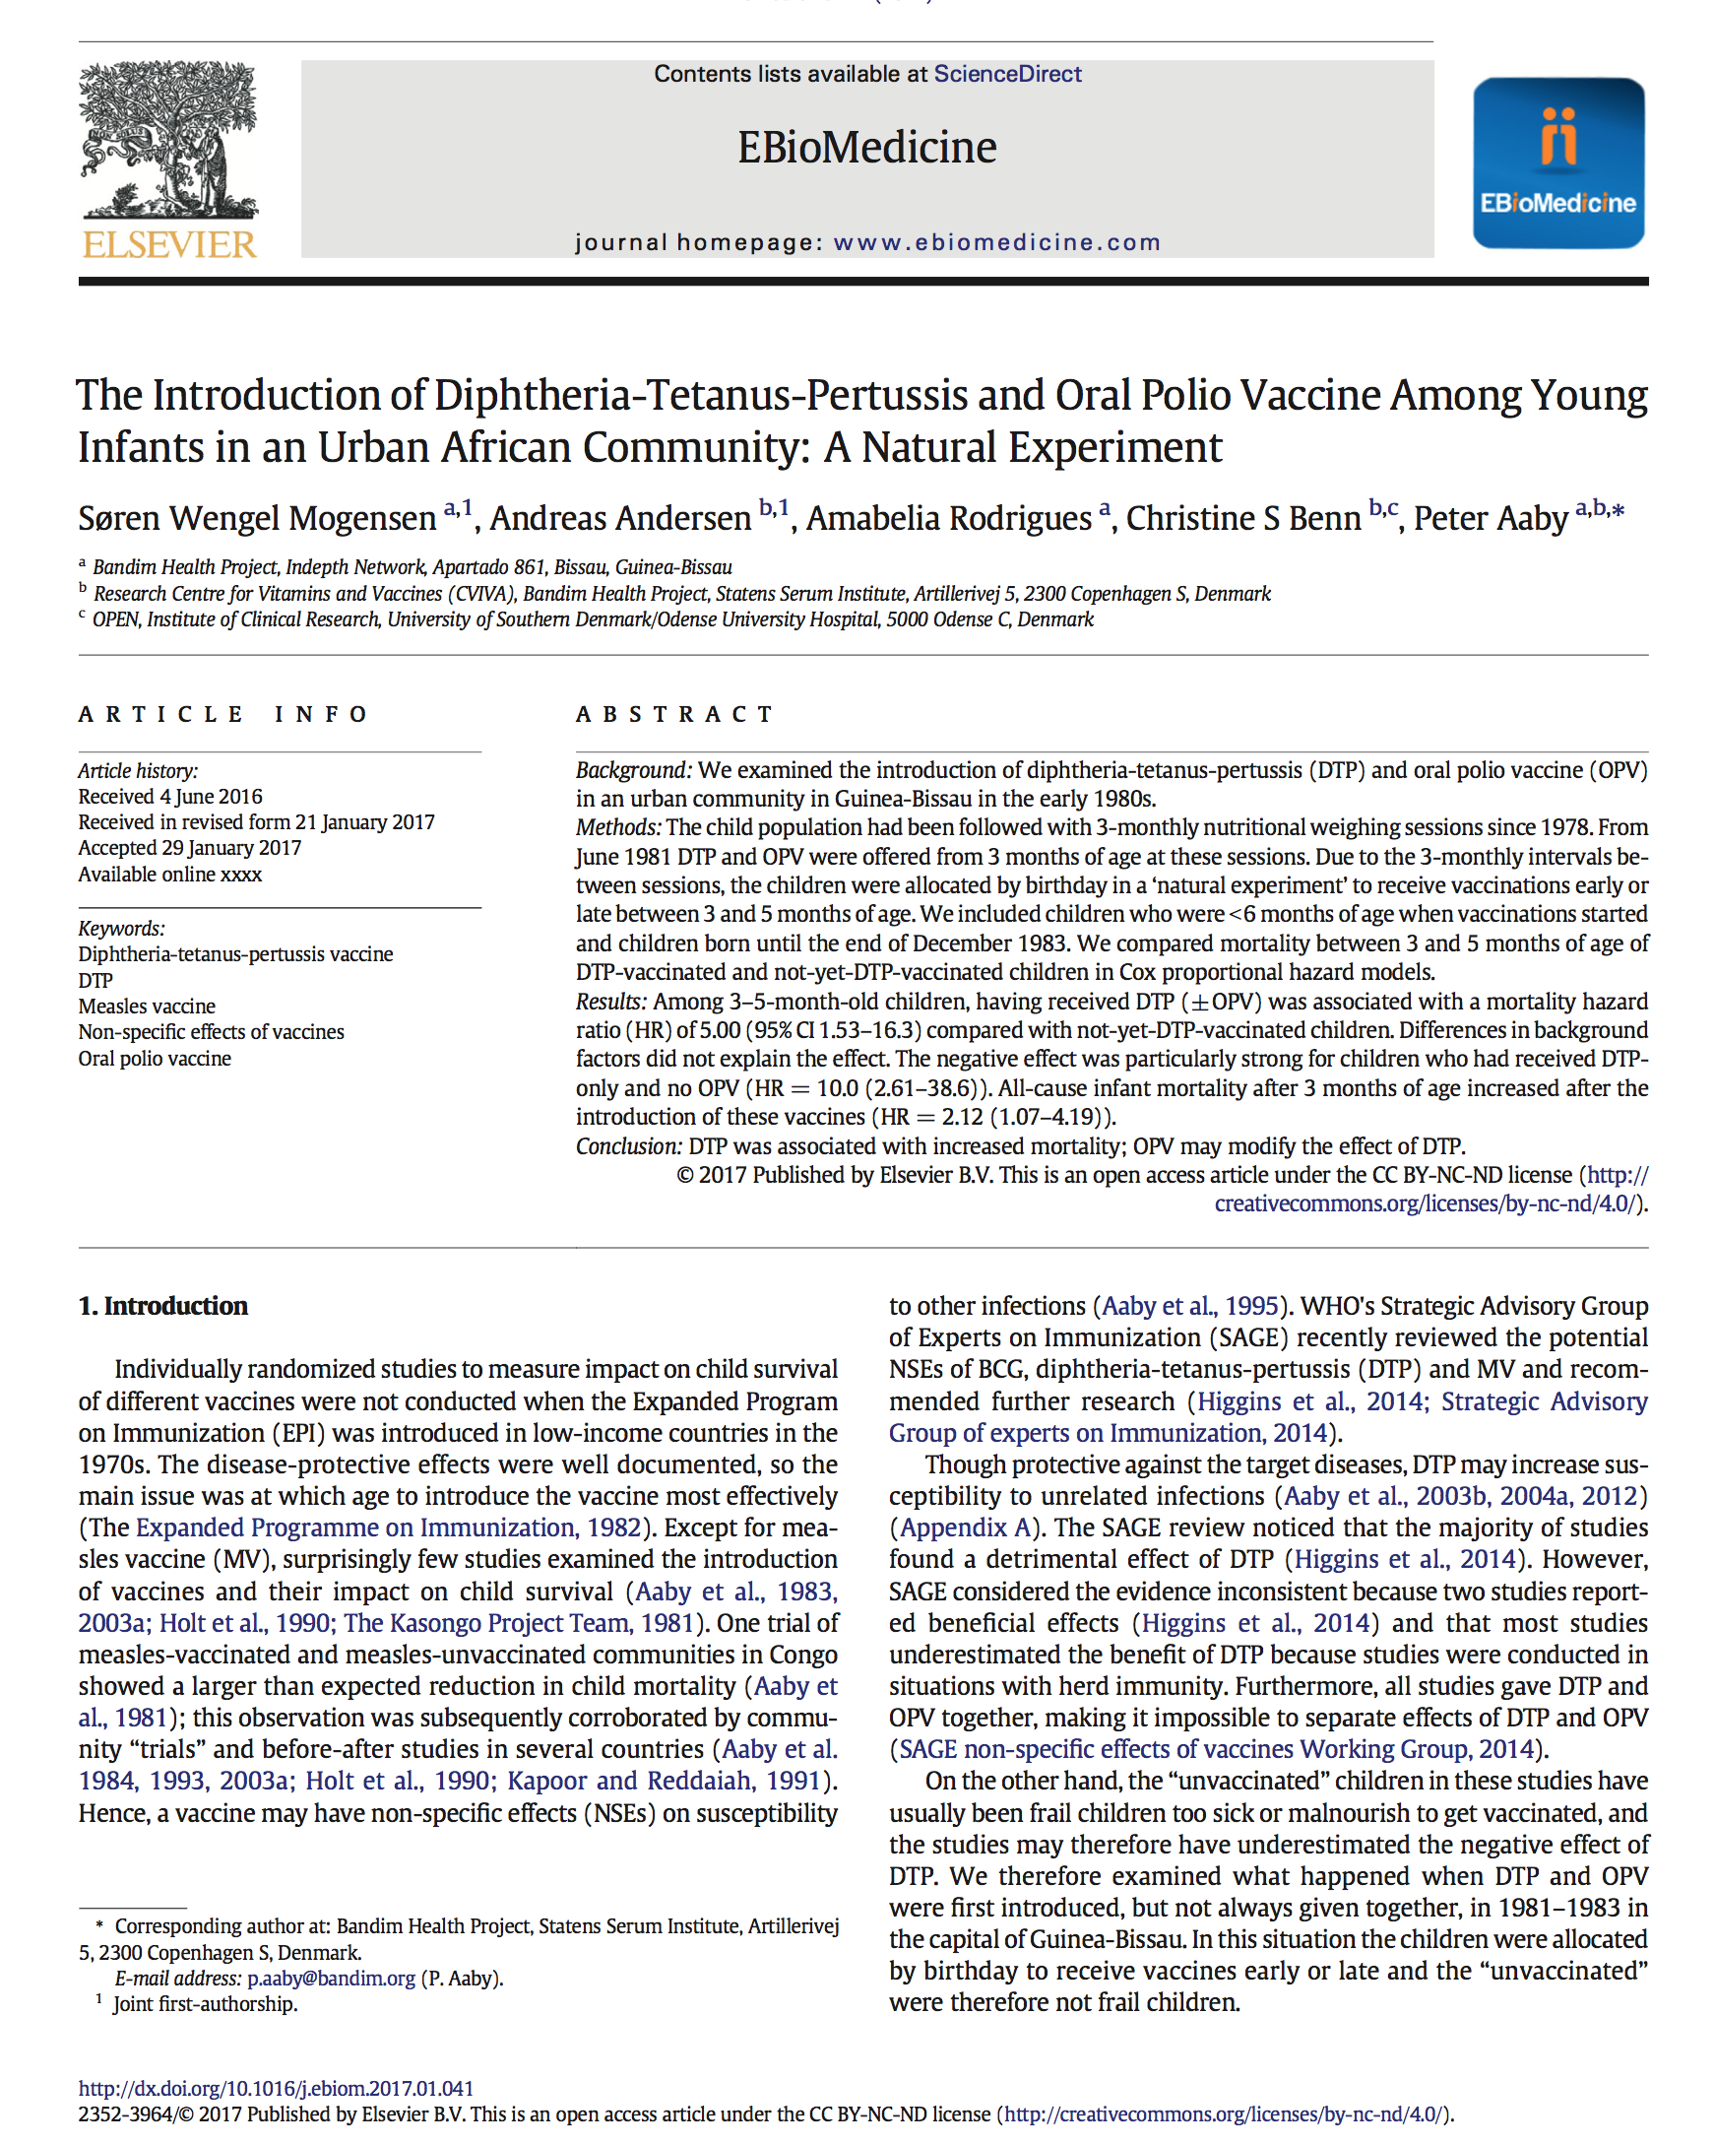
10x

Slide 3
Short list of Vaccine Adverse Events
(Compensated in Vaccine Court)
Guillain-Barre Syndrome (GBS)
Transverse Myelitis
Encephalopathy
Seizure Disorder
Death
Brachial Neuritis
Acute Disseminated Encephalomyelitis
Chronic Inflammatory Demyelinating Polyradiculoneuropathy (CIDP)
Premature Ovarian Failure
Bell’s Palsy
Juvenile Diabetes
Idiopathic Thrombocytopenic Purpura(ITP)
Rheumatoid Arthritis
Multiple Sclerosis (MS)
Fibromyalgia
Infantile Spasms
Anaphylaxis
Ocular Myasthenia Gravis
Hypoxic Seizure
(Listed on Vaccine Inserts)
Autoimmune Diseases
Food Allergies
Asthma
Eczema
Juvenile Diabetes
Rheumatoid Arthritis
Tics
Tourette Syndrome
ADD/ADHD
Autism
Speech Delay
Neurodevelopment Disorders
SIDS
Seizure Disorder
Narcolepsy
Epilepsy
Multiple Sclerosis

Slide 4
According to the CDC:
1 in 6 children has a developmental disability
*
ADD
ADHD
Autism
Hearing Loss
Learning Disability
Mental Disability
Seizures
Stammering
Stuttering
According to an HHS Funded Publication:
54% of children have chronic illness
†
Anxiety Problems
Asthma
Behavioral Problems
Bone and Muscle Disorders
Chronic Ear Infections
Depression
Diabetes
Digestive Allergies
Environmental Allergies
Epilepsy
Rheumatoid Arthritis
Seizure Disorder
*Source: https://www.cdc.gov/ncbddd/developmentaldisabilities/about.html
†Bethel et. al, 2011, A National and State Profile of Leading Health Problems and Health Care Quality for US Children: Key Insurance Disparities and Across-State Variations, Academic Pediatrics.

Slide 5
Number of Childhood Vaccine
Injections Administered
Childhood Chronic Illness &
Developmental Disability Prevalence
11
53
12.8%
†
*
54%
1986 schedule
2017 schedule
1986 prevalence
2011 prevalence
* Cleave et. al, 2010, Dynamics of Obesity and Chronic Health Conditions Among Children and Youth, JAMA.
†Bethel et. al, 2011, A National and State Profile of Leading Health Problems and Health Care Quality for US Children: Key Insurance Disparities and Across-State Variations, Academic Pediatrics.

Slide 6
I.
II.
III.
IV.
Intro
Who is Responsible for Vaccine Safety
Structural Conflicts of Interest in Vaccine Safety
Post-Licensure Vaccine Safety Surveillance
Simple & Immediate Solutions

Slide 7
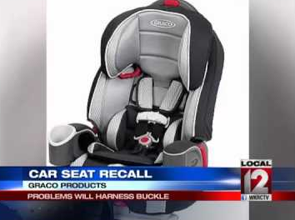
Who is Responsible for Vaccine Safety?

Slide 8
8
National Childhood Vaccine Injury Act
The 1986 Act
Immunity from Liability

Slide 9
National Childhood Vaccine Injury Act
Consequences?
No incentive to conduct safety studies
Liability free market of 78 million American children
Strong incentive to develop more vaccines

Slide 10
1986
2017
Near Future
11 Vaccines
53 Vaccines
100s of Vaccines
DTP (2 months)
Polio (2 months)
DTP (4 months)
Polio (4 months)
DTP (6 months)
MMR (15 months)
DTP (18 months)
Polio (18 months)
DTP (4 years)
Polio (4 years)
Tetanus (14 years)
Hepatitis B (one day)
Hepatitis B (one month)
DTaP (2 months)
Polio (2 months)
Hib (2 months)
PCV (2 months)
Rotavirus (2 months)
DTaP (4 months)
Polio (4 months)
Hib (4 months)
PCV (4 months)
Rotavirus (4 months)
DTaP (6 months)
Polio (6 months)
Hepatitis B (6 months)
Hib (6 months)
PCV (6 months)
Rotavirus (6 months)
Influenza (6 months)
MMR (12 months)
Varicella (12 months)
Hib (12 months)
Hepatitis A (12 months)
PCV (12 months)
DTaP (15 months)
Hepatitis A (18 months)
Influenza (18 months)
Influenza (2 years)
Influenza (3 years)
Influenza (4 years)
DTaP (4 years)
MMR (4 years)
IPV (4 years)
Varicella (4 years)
Influenza (5 years)
Influenza (6 years)
Influenza (7 years)
Influenza (8 years)
Influenza (9 years)
Influenza (10 years)
HPV (11 years)
Men ACWY (11 years)
Influenza (11 years)
TDaP (11 years)
HPV (11 ½ years)
Influenza (12 years)
Influenza (13 years)
Influenza (14 years)
Influenza (15 years)
Men ACWY (16 years)
Influenza (16 years)
Influenza (17 years)
Influenza (18 years)
Influenza (pregnancy)
Tdap (pregnancy)
Hepatitis B (one day)
Hepatitis B (one month)
DTaP (2 months)
Polio (2 months)
Hib (2 months)
PCV (2 months)
Rotavirus (2 months)
DTaP (4 months)
Polio (4 months)
Hib (4 months)
PCV (4 months)
Rotavirus (4 months)
DTaP (6 months)
Polio (6 months)
Hepatitis B (6 months)
Hib (6 months)
PCV (6 months)
Rotavirus (6 months)
Influenza (6 months)
MMR (12 months)
Varicella (12 months)
Hib (12 months)
Hepatitis A (12 months)
PCV (12 months)
DTaP (15 months)
Hepatitis A (18 months)
Influenza (18 months)
Influenza (2 years)
Influenza (3 years)
Influenza (4 years)
DTaP (4 years)
MMR (4 years)
Rubella (4 years)
Varicella (4 years)
Influenza (5 years)
Influenza (6 years)
Influenza (7 years)
Influenza (8 years)
Influenza (9 years)
Influenza (10 years)
HPV (11 years)
Influenza (11 years)
TDaP (11 years)
HPV (11 ½ years)
Influenza (12 years)
HPV (12 years)
Influenza (13 years)
Influenza (14 years)
Influenza (15 years)
MCV (16 years)
Influenza (16 years)
MenB (16 years)
Influenza (17 years)
Influenza (18 years)
Influenza (pregnancy)
Tdap (pregnancy)
Hepatitis B (one day)
Hepatitis B (one month)
DTaP (2 months)
Polio (2 months)
Hib (2 months)
PCV (2 months)
Rotavirus (2 months)
DTaP (4 months)
Polio (4 months)
Hib (4 months)
PCV (4 months)
Rotavirus (4 months)
DTaP (6 months)
Polio (6 months)
Hepatitis B (6 months)
Hib (6 months)
PCV (6 months)
Rotavirus (6 months)
Influenza (6 months)
MMR (12 months)
Varicella (12 months)
Hib (12 months)
Hepatitis A (12 months)
PCV (12 months)
DTaP (15 months)
Influenza (pregnancy)
Tdap (pregnancy)
Hepatitis B (one day)
Hepatitis B (one month)
DTaP (2 months)
Polio (2 months)
Hib (2 months)
PCV (2 months)
Rotavirus (2 months)
DTaP (4 months)
Polio (4 months)
Hib (4 months)
PCV (4 months)
Rotavirus (4 months)
DTaP (6 months)
Polio (6 months)
Hepatitis B (6 months)
Hib (6 months)
PCV (6 months)
Rotavirus (6 months)
Influenza (6 months)
MMR (12 months)
Varicella (12 months)
Hib (12 months)
Hepatitis A (12 months)
PCV (12 months)
DTaP (15 months)
Hepatitis A (18 months)
Influenza (18 months)
Influenza (2 years)
Influenza (3 years)
Influenza (4 years)
DTaP (4 years)
MMR (4 years)
Rubella (4 years)
Varicella (4 years)
Influenza (5 years)
Influenza (6 years)
Influenza (7 years)
Influenza (8 years)
Influenza (9 years)
Influenza (10 years)
HPV (11 years)
Influenza (11 years)
TDaP (11 years)
HPV (11 ½ years)
Influenza (12 years)
HPV (12 years)
Influenza (13 years)
Influenza (14 years)
Influenza (15 years)
MCV (16 years)
Influenza (16 years)
MenB (16 years)
Influenza (17 years)
Influenza (18 years)
Influenza (pregnancy)
Tdap (pregnancy)
Hepatitis B (one day)
Hepatitis B (one month)
DTaP (2 months)
Polio (2 months)
Hib (2 months)
PCV (2 months)
Rotavirus (2 months)
DTaP (4 months)
Polio (4 months)
Hib (4 months)
PCV (4 months)
Rotavirus (4 months)
DTaP (6 months)
Polio (6 months)
Hepatitis B (6 months)
Hib (6 months)
PCV (6 months)
Rotavirus (6 months)
Influenza (6 months)
MMR (12 months)
Varicella (12 months)
Hib (12 months)
Hepatitis A (12 months)
PCV (12 months)
DTaP (15 months)
Influenza (pregnancy)
Tdap (pregnancy)
Hepatitis B (one day)
Hepatitis B (one month)
DTaP (2 months)
Polio (2 months)
Hib (2 months)
PCV (2 months)
Rotavirus (2 months)
DTaP (4 months)
Polio (4 months)
Hib (4 months)
PCV (4 months)
Rotavirus (4 months)
DTaP (6 months)
Polio (6 months)
Hepatitis B (6 months)
Hib (6 months)
PCV (6 months)
Rotavirus (6 months)
Influenza (6 months)
MMR (12 months)
Varicella (12 months)
Hib (12 months)
Hepatitis A (12 months)
PCV (12 months)
DTaP (15 months)
Hepatitis A (18 months)
Influenza (18 months)
Influenza (2 years)
Influenza (3 years)
Influenza (4 years)
DTaP (4 years)
MMR (4 years)
Rubella (4 years)
Varicella (4 years)
Influenza (5 years)
Influenza (6 years)
Influenza (7 years)
Influenza (8 years)
Influenza (9 years)
Influenza (10 years)
HPV (11 years)

Slide 11
National Childhood Vaccine Injury Act
Who is responsible for vaccine safety?
HHS

Slide 12
I.
II.
III.
IV.
Intro
Who is Responsible for Vaccine Safety
Structural Conflicts of Interest in Vaccine Safety
Post-Licensure Vaccine Safety Surveillance
Simple & Immediate Solutions
Vaccine Safety
vs.
Promote/Defend Vaccines

Slide 13
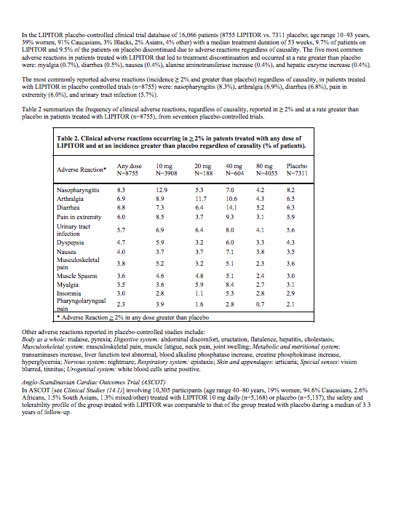
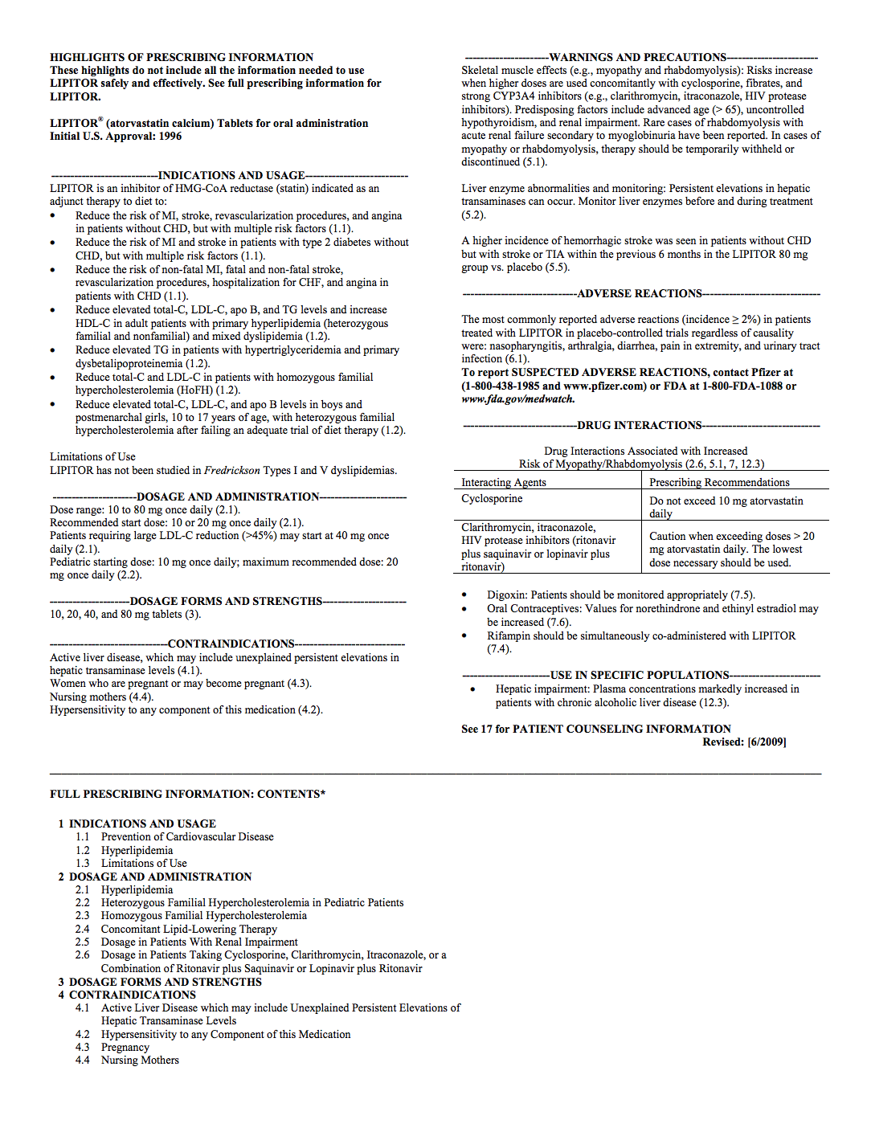
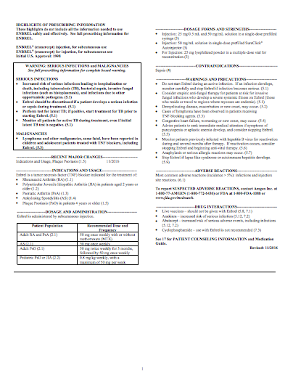
How Vaccines are Licensed, Recommended, Promoted, Defended
Product | Safety Review Period Prior to Licensure | Placebo Group
Lipitor | 4.8 Years | Sugar Pill
Enbrel | 6.6 Years | Saline Injection

Slide 14
How Vaccines are Licensed, Recommended, Promoted, Defended
Recommended Age (First Dose) | Vaccine/ Manufacturer | Safety Review Period Prior to Licensure | Subject Group | Placebo Group
1 Day Old | Hep-B (Engerix)/ GlaxoSmithKline | 4 Days | Hep-B | No Placebo
1 Day Old | Hep-B (Recombivax)/ Merck | 5 Days | Hep-B | No Placebo

Slide 15
How Vaccines are Licensed, Recommended, Promoted, Defended
Recommended Age (First Dose) | Vaccine/ Manufacturer | Safety Review Period Prior to Licensure | Subject Group | Placebo Group
1 Day Old | Hep-B (Engerix)/ GlaxoSmithKline | 4 Days | Hep-B | No Placebo
1 Day Old | Hep-B (Recombivax)/ Merck | 5 Days | Hep-B | No Placebo
2 Month Old | Polio (PVI- Monkey Kidney)/ Sanofi Pasteur | 48 hours | Polio + DTP | DTP

Slide 16
How Vaccines are Licensed, Recommended, Promoted, Defended
FDA’s Vaccine and Related Biological Products Advisory Committee (“VRBPAC”)
2000 Investigation Into VRBPAC by U.S. House Government Reform Committee:
“The overwhelming majority of members, both voting members and consultants, have substantial ties to the pharmaceutical industry.”
“conflict of interest rules employed by the FDA… have been weak, enforcement has been lax, and committee members with substantial ties to pharmaceutical companies have given waivers to participate in committee proceedings… In many cases, significant conflicts of interest are not deemed to be conflicts at all.”

Slide 17
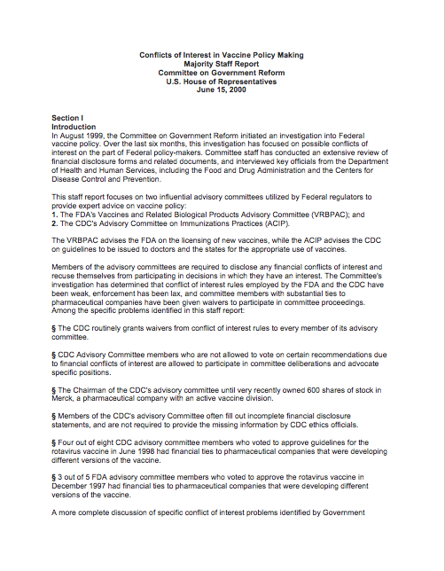
How Vaccines are Licensed, Recommended, Promoted, Defended
Example of Conflicts of Interest
For instance, “3 out of 5 FDA advisory committee [VRBPAC] members who voted to approve the rotavirus vaccine in December 1997 had financial ties to pharmaceutical companies that were developing different versions of the vaccine.”
1 of the 5 voting members’ employer had a $9,586,000 contract for a rotavirus vaccine.
1 of the 5 voting members was the principal investigator for a Merck grant to develop a rotavirus vaccine.
1 of the 5 voting members received appx. $1,000,000 from vaccine manufacturers toward vaccine development.

Slide 18
How Vaccines are Licensed, Recommended, Promoted, Defended
Advisory Committee on Immunization Practices (“ACIP”)
An ACIP vote to recommend a vaccine results in:
Mandating the vaccine to millions of children.
Immunity from liability for the manufacturer.
Inclusion in the Vaccine for Children program.
Liability free captive market of 78 million American children with guaranteed payment

Slide 19
How Vaccines are Licensed, Recommended, Promoted, Defended
2000 - Investigation Into ACIP by U.S. Government Reform Committee:
“The CDC grants blanket waivers to the ACIP members each year that allow them to deliberate on any subject, regardless of their conflicts, for the entire year.”
ACIP reflects “a system where government officials make crucial decisions affecting American children without the advice and consent of the governed.”

Slide 20
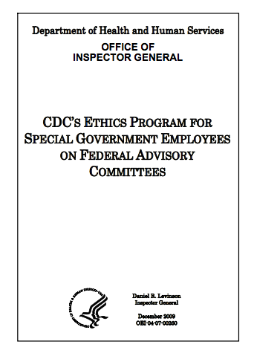
How Vaccines are Licensed, Recommended, Promoted, Defended
2009 – HHS Office of Inspector General Investigation
“CDC had a systemic lack of oversight of the ethics program”
97 percent of committee members’ conflict disclosures had omissions.
58 percent had at least one unidentified potential conflict.
32 percent had at least one conflict that remained unresolved.
CDC continued to grant broad waivers to members with conflicts.

Slide 21
How Vaccines are Licensed, Recommended, Promoted, Defended
CDC’s Budget: $11.5 Billion
*Numbers are approximate

Slide 22
How Vaccines are Licensed, Recommended, Promoted, Defended
2002-2009: Former CDC Director, Julie Gerberding oversaw numerous vaccine studies, many of which were recently deemed unreliable by the IOM.
2010: Became President of Merck Vaccines with estimated $2.5 million annual salary and lucrative stock options.

Slide 23
How Vaccines are Licensed, Recommended, Promoted, Defended
Americans Injured by a Vaccine Must File a Claim in the VACCINE INJURY COMPENSATION PROGRAM (“VICP”) where:
All filings are submitted under seal.
They must fight against HHS (the Respondent)
They must fight against DOJ (the Respondent’s counsel)
They must fight without any discovery as-of-right
They must almost always prove causation

Slide 24
How Vaccines are Licensed, Recommended, Promoted, Defended
$3,737,884,487
Despite extremely high hurdle to obtain compensation, VICP has paid over $3.7 billion for vaccine injuries and this is with cap of $250k for pain and suffering and death.

Slide 25
How Vaccines are Licensed, Recommended, Promoted, Defended
Representative Bill Posey

Slide 26
How Vaccines are Licensed, Recommended, Promoted, Defended

Slide 27
Conflict of Interest Summary
Industry incentivized to not conduct proper safety testing
Regulatory agency incentivized to not conduct safety testing
Regulatory function subsumed to promoting, distributing and defending vaccines

Slide 28
I.
II.
III.
IV.
Intro
Who is Responsible for Vaccine Safety
Structural Conflicts of Interest in Vaccine Safety
Post-Licensure Vaccine Safety Surveillance
Simple & Immediate Solutions

Slide 29
1986 Act: Vaccine Adverse Events Reporting System (VAERS)
5,911,700
In 2016, VAERS received 59,117 reports including:
43,200
109,100
413,200
1,028,400
432 deaths,
1,091 permanent disabilities,
4,132 hospitalizations, and
10,284 emergency room visits.
“fewer than 1% of adverse events are reported”
(Source: Report Funded by HHS)
“Former FDA Commissioner David A. Kessler has estimated that VAERS reports currently represent only a fraction of the serious adverse events.”
(Source: U.S. Congressional Report)

Slide 30
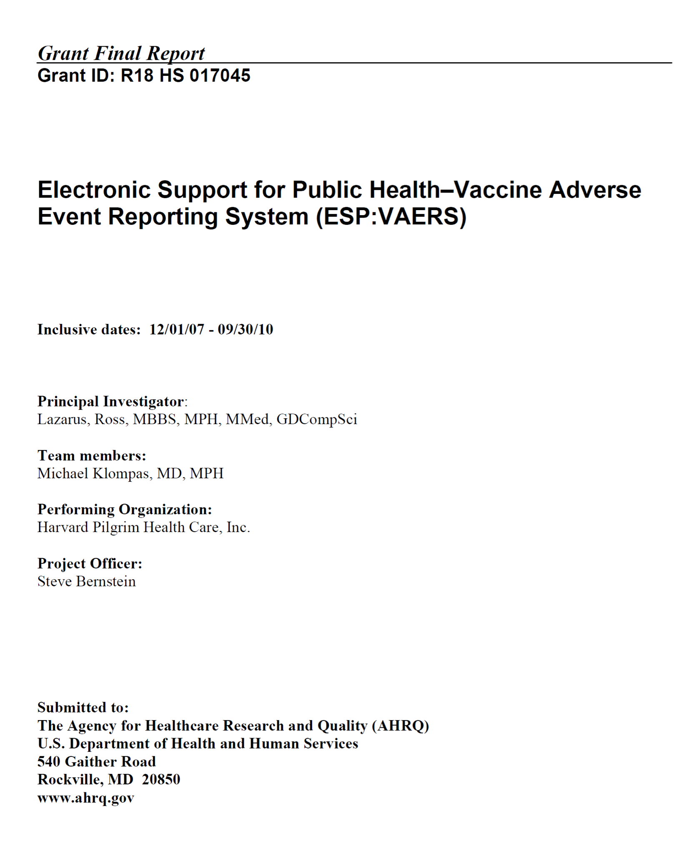
AUTOMATING VAERS

Slide 31
AUTOMATING VAERS

Slide 32
Lack of Vaccine Safety Science
Institute of Medicine Reports on Vaccine Safety
Year of IOM Report | Vaccines Reviewed | # of Conditions Studied | Literature Supports Causation | Literature Rejects Causation | Literature Inadequate to Accept or Reject Causation
1991 | DTP | 22 | 6 | 4 | 12
Aseptic meningitis; Chronic neurologic damage; Learning disabilities and attention-deficit disorder; Hemolytic anemia; Juvenile diabetes; Guillain-Barre syndrome; Erythema multiforme; Peripheral mononeuropathy; Radiculoneuritis and other neuropathies; Thrombocytopenia; Thrombocytopenic purpura

Slide 33
Lack of Vaccine Safety Science
Institute of Medicine Reports on Vaccine Safety
Year of IOM Report | Vaccines Reviewed | # of Conditions Studied | Literature Supports Causation | Literature Rejects Causation | Literature Inadequate to Accept or Reject Causation
1994 | DT, MM, Hep-B & Hib | 54 | 12 | 4 | 38
A partial list of the 38 conditions: Demyelinating diseases of the central nervous system, Sterility, Arthritis, Neuropathy, Residual seizure disorder, Transverse myelitis, Sensorineural deafness, Optic neuritis, Aseptic meningitis, Insulin-dependent diabetes mellitus, SIDS

Slide 34
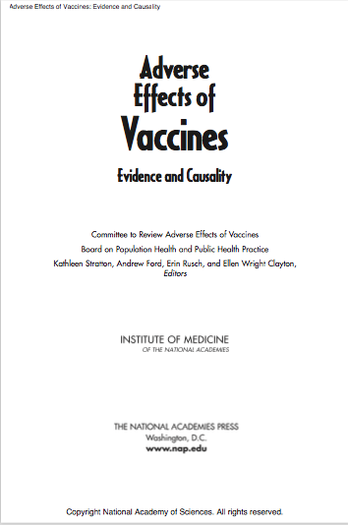
Lack of Vaccine Safety Science
Institute of Medicine Reports on Vaccine Safety
Year of IOM Report | Vaccines Reviewed | # of Conditions Studied | Literature Supports Causation | Literature Rejects Causation | Literature Inadequate to Accept or Reject Causation
2011 | Varicella, T, Hep-B, MMR | 155 | 16 | 5 | 135
A partial list of the 134 conditions: Encephalitis, Encephalopathy, Infantile Spasms, Afebrile Seizures, Seizures, Cerebellar Antaxia, Anataxia, Autism, Acute Disseminated Encephalomyelitis, Transverse Myelitis, Optic Neuritis, Neuromyelitis Optica, Multiple Sclerosis, Guillain-Barre Syndrome, Chronic Inflammatory Demyelinating Polyneuropathy, Brachial Neuritis, Amyotrophic Lateral Sclerosis, Small Fiber Neuropathy, Chronic Urticaria, Erythema Nodosum, Systemic Lupus Erythematosus, Polyarteritis Nodosa, Psoriatic Arthritis, Reactive Arthritis, Rheumatoid Arthritis, Juvenile Idiopathic Arthritis, Arthralgia, Autoimmune Hepatitis, Stroke, Chronic Headache, Fibromyalgia, Sudden Infant Death Syndrome, Hearing Loss, Thrombocytopenia, Immune Thrombocytopenic Purpura

Slide 35
Lack of Vaccine Safety Science
Institute of Medicine Reports on Vaccine Safety
2011 IOM Report

Slide 36
Childhood Vaccines
Vaccine Ingredients
(Partial List)
Hepatitis B (1 day)
Hepatitis B (1 month)
DTaP (2 months)
Polio (2 months)
Hib (2 months)
PCV (2 months)
Rotavirus (2 months)
DTaP (4 months)
Polio (4 months)
Hib (4 months)
PCV (4 months)
Rotavirus (4 months)
DTaP (6 months)
Polio (6 months)
Hepatitis B (6 months)
Hib (6 months)
PCV (6 months)
Rotavirus (6 months)
Influenza (6 months)
MMR (12 months)
Varicella (12 months)
Hib (12 months)
Hepatitis A(12 months)
PCV (12 months)
DTaP (15 months)
Hepatitis A(18 months)
Influenza (18 months)
Influenza (2 years)
Influenza (3 years)
Influenza (4 years)
DTaP (4 years)
MMR (4 years)
IPV (4 years)
Varicella (4 years)
Influenza (5 years)
Influenza (6 years)
Influenza (7 years)
Influenza (8 years)
Influenza (9 years)
Influenza (10 years)
HPV (11 years)
Men ACWY (11 years)
Influenza (11 years)
TDaP (11 years)
HPV (11 ½ years)
Influenza (12 years)
Influenza (13 years)
Influenza (14 years)
Influenza (15 years)
Men ACWY (16 years)
Influenza (16 years)
Influenza (17 years)
Influenza (18 years)
2-phenoxethanol
Complex fermentation medium Detergent
5 rdimethyl
1-beta-cyclodextrin
Eagle MEM modified medium
Enzymes
Formaldahyde
Gelatin
Glutaraldehide
Heminchloride
Hydrolyzed galtin
Lactalbumin hydrolysate
Medium 199
Minimum Essential Medium
Modified Mueller’s growth medium
Modified Stainer-Scholte liquid medium
Neomycin
Neomycin Sulphate
Phenol polymyxin B
Polymyxin B Sulphate
Polysorbate 80
Soy Peptone
Stainer-Scholte medium
Streptomycin
Yeast
Yeast Protein
thimerosal

Slide 37
Lack of Vaccine Safety Science
Dr. Bernadine Healy, Former Head of NIH

Slide 38
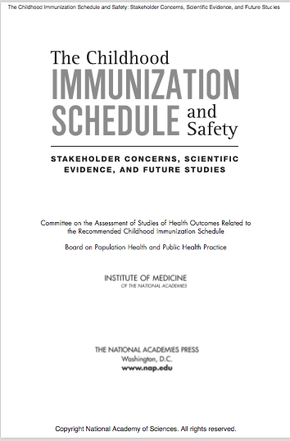
Lack of Vaccine Safety Science
2013 IOM Report on Safety of Entire Immunization Schedule
2008 Interview 5 years later

Slide 39
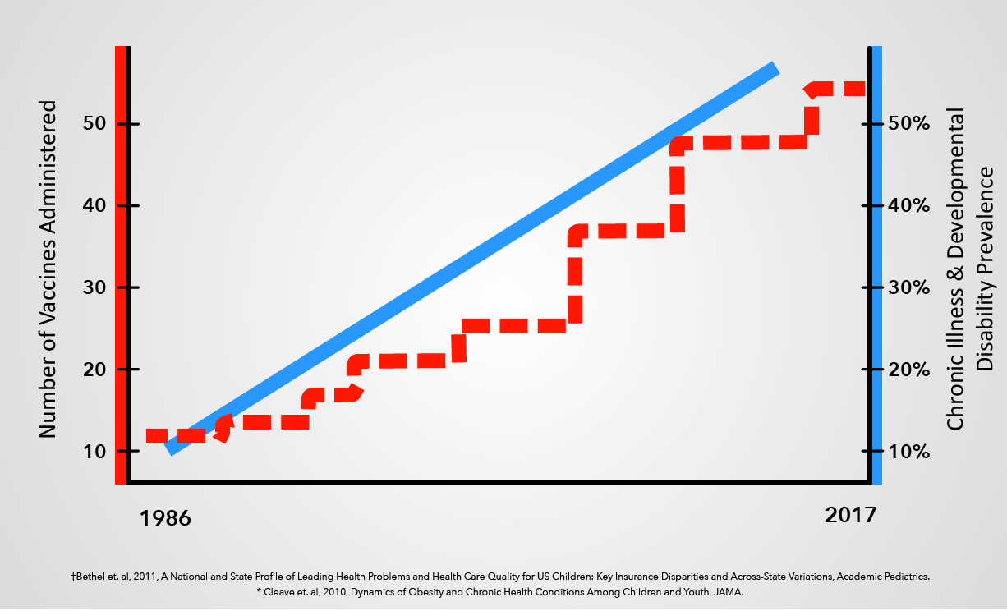
Lack of Vaccine Safety Science
Vaccinated vs. Unvaccinated
CDC’s VACCINE SAFETY DATALINK (VSD) has Health Records of Approximately 10 Million Individuals Including Hundreds of Thousands of Children
IOM in 2011 “It is possible to make this comparison [vaccinated v. unvaccinated children] through analyses of patient information contained in large databases such as VSD.”
Who is the CDC trying to protect by not conducting this study?

Slide 40
Lack of Vaccine Safety Science
Vaccinated vs. Unvaccinated
10x

Slide 41
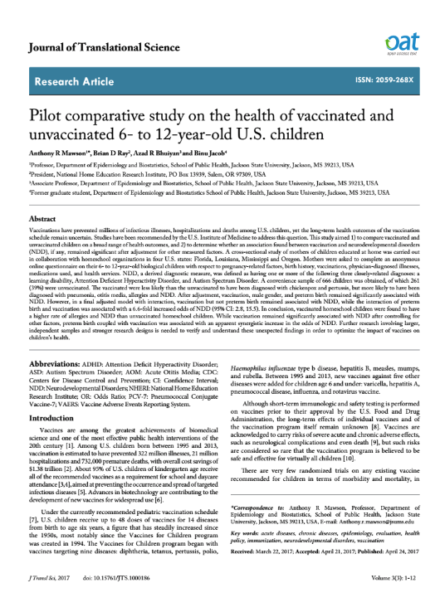
Vaccinated vs. Unvaccinated Study (Homeschoolers, 2017)
Odds ratio of chronic diseases for vaccinated children vs. unvaccinated children
Rhinitis
30
Learning
Disability
5.2
ADHD
4.2
Autism
4.2
Neurodev.
Disorder
3.7
Allergy
3.9
Eczema
2.9
600 kids

Slide 42
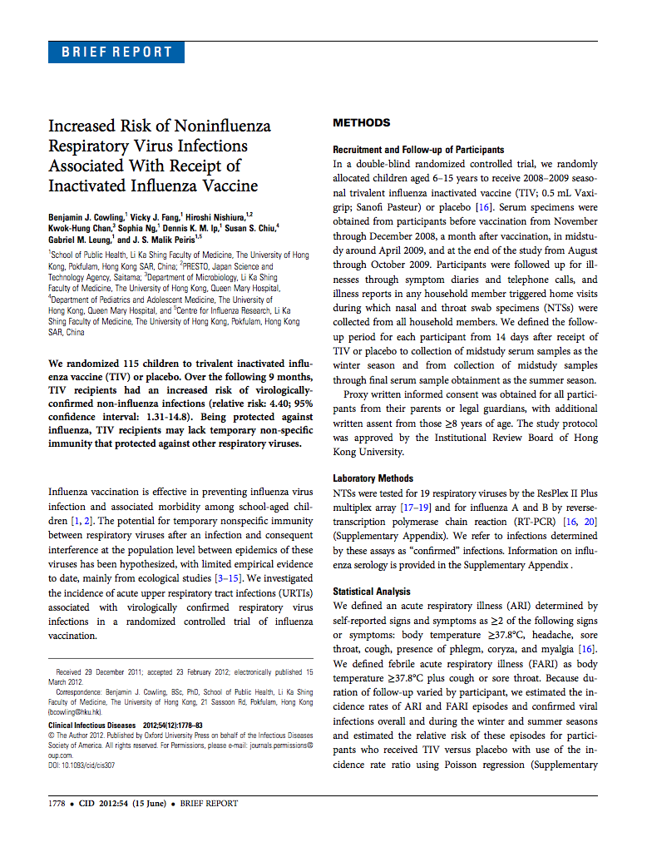
Lack of Vaccine Safety Science
Double Blind Flu Study
Flu shot group and placebo group had same rate of influenza infection.
Flu shot group had 4.4x higher rate of non-influenza infection.

Slide 43
Lack of Vaccine Safety Science
HHS’s Ethical, Moral and Statutory Duty
Paralysis resulting in Quadriplegia

Slide 44
Solutions that can be implemented immediately:
Transparent Surveillance
HHS grant open access to Vaccine Safety Datalink for independent studies.
Prohibit any conflict waivers for members of HHS’s vaccine committees.*
Require members of HHS’s vaccine committees* to contractually agree not to accept any compensation, directly or indirectly, from any vaccine manufacturer for at least five years.
Require vaccine safety advocates comprise at least fifty percent of HHS’s vaccine committees.*
Test all existing and future vaccines against a saline placebo for a duration sufficient to identify chronic illness.
Reduce Conflict
Increase Safety Profile
*HHS’s Vaccine Committees = ACIP, VRBPAC, NVAC, ACCV

