Slide 1
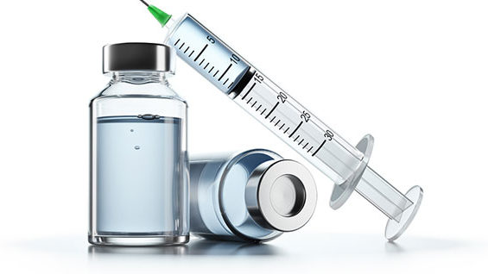
SARS-CoV-2 mRNA vaccines: Is the Risk Worth the Benefit?
Dr. Stephanie Seneff, MIT CSAIL
Panda Open Science Meeting
Tuesday, March 1, 2022

Slide 2
Outline
Overview
Spike Protein and Neurodegenerative Disease
Exosomes, MicroRNAs and Heart Disease
Spike Protein and Cancer
Spike Protein and Thrombosis
Spike Antibodies and Autoimmune Disease
Summary

Slide 3
Overview

Slide 4
“Worse than the Disease? Reviewing Some Possible Unintended Consequences of the mRNA Vaccines Against COVID-19”*
The mRNA vaccines are a poorly evaluated novel technology with many unknowns
Some potential adverse consequences:
Pathogenic priming, multisystem inflammatory disease and autoimmunity
Allergic reactions and anaphylaxis
Antibody dependent enhancement
Activation of latent viral infections
Neurodegeneration and prion diseases
Emergence of novel variants of SARS-CoV-2
Potential for integration of the spike protein gene into human DNA
*S Seneff and G Nigh. IJVTPR 2021; 2(1): 38-79.
Notes:
https://dailyexpose.co.uk/2021/06/10/dr-tess-lawrie-demands-dr-june-raine-the-chief-exec-of-mhra-halts-the-covid-vaccine-programme-immediately-due-to-severe-adverse-reactions-and-deaths/
James Lyons Weiler has a paper about pathogenic priming.

Slide 5
The RNA Life Cycle*
5’ cap
The mRNA vaccines are cleverly designed to contain mRNA that is perfectly set up to churn out spike proteins with no way to turn off the spigot
5’ cap and long poly(A) tail added to make it look like a human protein
Select hearty 3’UTR to resist silencing
Modified nucleotides to resist breakdown (1-methyl-pseudouridine)
Enhancement of G and C over A and U to promote rapid protein synthesis
poly(A) tail
3’UTR
*Figure 1. Florian J. Bock et al. Mol Cell. 2015 June 18; 58(6): 959–969.
Notes:
https://www.ncbi.nlm.nih.gov/pmc/articles/PMC4475274/
COVD_vaccine/RNA_regulation_by_PARPs_2015.pdf
adenine

Slide 6
mRNA vaccines contain the genetic code to make spike protein
The RNA is carefully engineered to resist breakdown
All of the uridines are replaced with 1-methyl-pseudouridine (m1Ψ)
The mRNA is incorporated into a lipid particle that simulates a human LDL particle
A synthetic cationic (positively charged) lipid is added to act as an adjuvant – very toxic to the cells
The “humanized” mRNA is a stealth entry system for massive production of spike protein

Slide 7
The Action is in the Germinal Centers*
The germinal center (GC) is a specialized microstructure that forms in secondary lymphoid tissues (e.g., lymph nodes and spleen)
produce long-lived antibody-secreting plasma cells and memory B cells
provide protection against reinfection
Within the GC, B cells undergo somatic mutation to achieve successful selection
B cell clones that bind antigen with high affinity emerge from this process
However, this mutation process can also be dangerous, as it can create autoreactive clones that can cause autoimmunity
*Marisa Stebegg et al. Frontiers in Immunology 2018; 9: Article 2469.
Notes:
https://www.frontiersin.org/articles/10.3389/fimmu.2018.02469/full

Slide 8
"Nucleoside-modified mRNA vaccines induce potent T follicular helper and germinal center B cell responses"*
"Nucleoside-modified" means that all the uridines in the mRNA were replaced with 1-methyl-pseudouridine
This replacement resulted in robust synthesis of protein from the mRNA code (protected RNA from degradation)
Result was a very strong antibody response due to formation and maintenance of germinal centers in the spleen
Another study showed that repeated exposure to antigen (foreign protein) through immunization resulted in increased susceptibility to prion protein exposure**
Attributed to expansion of splenic germinal centers
*Norbert Pardi et al. J. Exp. Med. 2018 Vol. 215 No. 6 1571–1588
**Juliane Bremer et al., PLoS ONE 2009; 4(9): e7160.
Notes:
csail/2022/Rome/methylpseudouridine_induces_germinal_centers_spleen_antibody_response.pdf
csail/2022/Rome//repetitive_immunization_enhances_prion_effect_mice.pdf

Slide 9
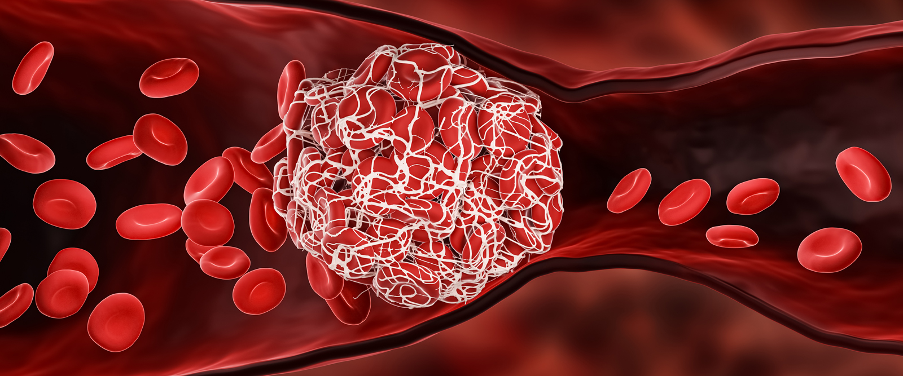
The mRNA in the vaccines is long-lasting and induces strong IgG response*
Lymph nodes of vaccine recipients show abundant germinal centers
Vaccination induces stronger IgG response than the disease
The mRNA from the vaccines and spike proteins remain in germinal centers in lymph nodes for up to 60 days
A strong IgG response can lead to platelet activation and blood clots!!
*Katharina Röltgen et al. Cell January 25, 2022 [Epub ahead of print]. https://doi.org/10.1016/j.cell.2022.01.018
Notes:
https://www.sciencedirect.com/science/article/pii/S0092867422000769

Slide 10
Spike Protein and Neurodegenerative Disease

Slide 11
The Big Picture
A natural infection starts in the nose and lungs and never makes it into general circulation if the immune system is healthy
Injection of spike mRNA nanoparticles into deltoid muscle bypasses mucosal and vascular barriers
Immune cells take up mRNA nanoparticles and carry them into the lymph system, ultimately into the spleen
Immune cells in the spleen release large quantities of spike protein displayed on the surface of exosomes
These exosomes disperse throughout the body, but, especially, travel to the brain to deliver the toxic prion-like spike protein to neurons
Inflammatory response in the brain induces neurological damage

Slide 12
DarkHorsePodcast - Dr. Brett Weinstein, Dr. Robert Malone and Mr. Steve Kirsch*
There was no evaluation of reproductive toxicity or genotoxicity in animals before the mRNA vaccines were authorized for humans
A FOIA request from doctors in Canada yielded a Pfizer study written in Japanese
The lipid nanoparticles went everywhere in the body but were found in especially high concentrations in the animals’ lymph nodes, spleen, ovaries, adrenal glands, liver and bone marrow.
Dr. Malone is an early developer of mRNA vaccine technology
https://www.youtube.com/watch?v=-_NNTVJzqtY (CENSORED)
Part 1: https://www.brighteon.com/fc163ab1-82f9-4f2b-b921-7b877923f315
Part 2: https://www.brighteon.com/00b257ec-2077-40b6-88a9-93d8d8451959
Notes:
From Meryl Nass post:
https://anthraxvaccine.blogspot.com/2021/07/in-this-incredibly-important-video-mrna.html

Slide 13
Loss of smell is a common early symptom of Parkinson's and of COVID-19
Virus can gain access to brain along nerve fibers
Olfactory nerve
Vagus nerve
Neuroinvasion of SARS-COV-2 could upregulate α-synuclein
High levels of α-synuclein leads to misfolding and toxicity
Dopaminogenic neurons in substantia nigra express high levels of the ACE2 receptor

Slide 14
Three independent case reports have described the development of Parkinson’s disease following COVID-19.*
Loss of smell is a common early symptom of Parkinson's and of COVID-19
Virus can gain access to brain along nerve fibers
Olfactory nerve
Vagus nerve
Neuroinvasion of SARS-COV-2 could upregulate α-synuclein
High levels of α-synuclein leads to misfolding and toxicity
Dopaminogenic neurons in substantia nigra express high levels of the ACE2 receptor
* Ernesto Estrada Viruses 2021; 13: 897.

Slide 15
Exosomes and Parkinson’s Disease*
Parkinson’s disease often begins in the gut as an immune reaction to prion-like proteins produced by pathogens
The spike protein is a prion-like protein**
It contains 6 glycine zippers (GxxxG) – a characteristic signature of prions
(The human prion protein contains 15, and amyloid beta (linked to Alzheimer’s disease) contains only 4)
Stressed immune cells in the digestive tract and spleen upregulate α-synuclein and release it packaged up in exosomes, along with foreign misfolded proteins
The exosomes travel along the vagus nerve to the brain stem nuclei
Damage to the substantia nigra causes Parkinson’s disease
The whole process can take years or decades before symptoms appear
*S Seneff and G Nigh. IJVTPR 2021; 2(1): 38-79.
**George Tetz and Victor Tetz. Microorganisms 2022; 10: 280.

Slide 16
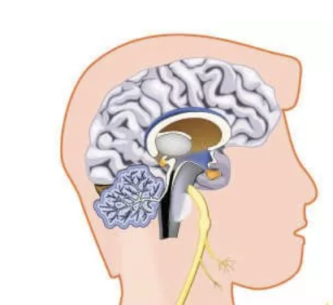
2. Exosomes carry spike protein and alpha-synuclein from germinal centers in the spleen to the brain along the vagus nerve
How mRNA Vaccines can Cause Neurodegenerative Disease
3. Spike protein and alpha synuclein taken up by neurons in the substantia nigra are neurotoxic – increased future risk to Parkinson’s disease
Substantia
Nigra
Vagus Nerve
Exosome containing spike and alpha-synuclein
Germinal Center in Spleen
1. Immune cells in the spleen stressed by excess spike synthesis release exosomes containing spike protein

Slide 17
“Pilot study suggests long COVID could be linked to the effects of SARS-CoV-2 on the vagus nerve”*
“Vagus Nerve Symptoms: dysphonia (persistent voice problems), dysphagia (difficulty in swallowing), dizziness, tachycardia (abnormally high heart rate), orthostatic hypotension (low blood pressure) and diarrhoea.”
Reaction | COVID vaccines (2021) | All vaccines (2021) | Percent COVID
Diarrhoea | 23,128 | 23,861 | 96.9
Tachycardia | 5,524 | 5,653 | 97.7
Dizziness | 69843 | 71648 | 97.5
Dysphagia | 4,714 | 4,837 | 97.5
Dysphonia | 1,693 | 1,752 | 96.6
Orthostatic Hypotension | 172 | 180 | 95.5
*G Lladós and L Mateu. European Congress of Clinical Microbiology and Infectious Diseases (ECCMID 2022, Lisbon, 23-26 April).
*https://www.eurekalert.org/news-releases/943102
Notes:
https://www.eurekalert.org/news-releases/943102
COVID_vax/pilot_study_vagus_nerve_long_COVID.pdf
dysphonia (persistent voice problems), dysphagia (difficulty in swallowing), dizziness, tachycardia (abnormally high heart rate), orthostatic hypotension (low blood pressure) and diarrhoea.

Slide 18
SARS-CoV-2 Spike Activates Human Microglia in the Brain via Exosomes Loaded with miRNAs*
"SARS-CoV-2 spike transfected cells release many exosomes loaded with microRNAs such as miR-148a and miR-590”
"MicroRNAs get internalized by human microglia in the brain”
Induce a strong inflammatory response
The microRNAs disrupt type I interferon response, which is an essential part of innate immunity
"These results uncover a bystander pathway of SARS-CoV-2 mediated CNS [central nervous system] damage through hyperactivation of human microglia”
*Ritu Mishra and Akhil C. Banerjea. Frontiers in Immunology 2021; 12:656700
Notes:
prions/exosomes_spike_WOW.pdf

Slide 19
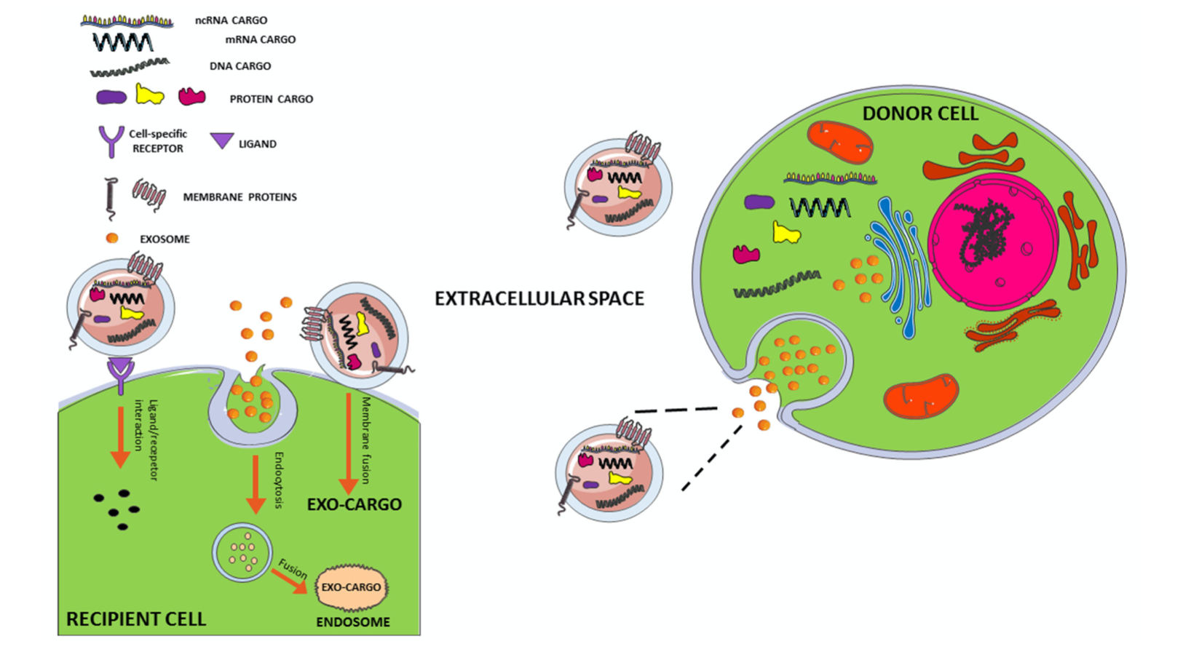
Exosome Transfer from Cell to Cell*
exosome
Endocytosis
Ligand
Receptor
Membrane
Fusion
*Figure 1. Marianna D’Anca et al. Front. Aging Neurosci. 28 August 2019; 11: 232.

Slide 20
Problems with the vaccine spike protein*
"Is it possible the spike protein itself causes the tissue damage associated with Covid-19?”
A “furin cleavage site” in the spike protein allows S1 subunit to be snipped off and released into circulation
The S1 subunit localizes to the endothelia of microvessels in the mouse brain and is a potent neurotoxin."
"So the spike S1 subunit of SARS-CoV-2 alone is capable of being endocytosed by ACE2 positive endothelia in both human and mouse brain, with a concomitant paucicellular microencephalitis that may be the basis for the neurologic complications of COVID-19."
*https://beta.regulations.gov/document/FDA-2020-N-1898-0246
Comment from J. Patrick Whelan MD PhD
Food and Drug Administration on Dec 8, 2020

Slide 21
“Alzheimer's-like signaling in brains of COVID-19 patients”*
Symptoms of long-haul COVID include brain fog, reduced consciousness, and tingling and prickling sensations related to nerve damage
The spike protein binds to ACE2 receptors in the brain and disables them
SARS-CoV-2 infection activates inflammatory signaling and oxidative stress pathways in the brain
Reduced ACE2 activity has been associated with tau hyperphosphorylation and increased amyloid beta in animal models of Alzheimer's disease
The COVID vaccines deliver spike protein to the brain via exosomes
*Steve Reiken et al. Alzheimer's & Dementia Feb 3, 2022 [Epub ahead of print]. https://doi.org/10.1002/alz.12558

Slide 22
"COVID-19 Vaccine Associated Parkinson’s Disease, A Prion Disease Signal in the UK Yellow Card Adverse Event Database.”*
“All the COVID-19 vaccines on the market contain spike protein or its nucleic acid sequence creating a possible catastrophic epidemic of prion disease in the future.”
“This analysis should serve as an urgent warning to those mindlessly following advice of politicians and public health officials regarding COVID immunization.”
*J Bart Classen. J Med - Clin Res & Rev. 2021; 5(7): 1-6.

Slide 23
VAERS Adverse Events Related to Neurodegeneration, 2021*
Condition | COVID vaccines (2021) | All vaccines (2021) | Percent COVID
Memory Impairment | 1,681 | 1,720 | 97.7
Amnesia | 1,360 | 1,419 | 95.8
Mobility Decreased | 8,974 | 9,742 | 92.1
Alzheimer's | 37 | 39 | 94.9
Parkinson’s Disease | 91 | 97 | 93.8
Dysphagia (Difficulty Swallowing) | 4,711 | 4,835 | 97.4
Anosmia (Loss of Smell) | 3,657 | 3,677 | 99.5
*US Vaccine Adverse Event Reporting System: http://wonder.cdc.gov/vaers.html

Slide 24
Notes:
http://dx.doi.org/10.13140/RG.2.2.14427.03366

Slide 25
Exosomes, MicroRNAs and Heart Disease

Slide 26
The Big Picture
Stressed immune cells release exosomes containing microRNAs that signal to tissue cells and can induce an inflammatory response
In particular, miR-155 plays a special role in SARS-CoV-2, facilitated by spike
The spike protein S1 subunit detaches and becomes free to bind to ACE2 receptors which are present at high levels in the heart
The suppression of ACE2 by spike S1 causes upregulation of angiotensin II, which induces inflammation (myocarditis) and cardiovascular disease
S1 has been found in COVID-19 patients long after the virus is cleared, and is believed to play a critical role in “long-haul COVID”
S1 has also been found in the vasculature following vaccination
miR-155 overexpression is linked to worse outcomes in heart attack

Slide 27
“Exosomes take (germinal) center stage”*
Wild Type
Rab27-/-
miR-155-3p
Horizontal transfer of microRNAs via exosomes from T to B cells is necessary for germinal center formation and efficient antibody production
miR-155-3p silences PTEN and BiM, supporting B cell maturation and proliferation
However, miR-155 is also associated with many autoimmune diseases**
*Figure 1. Jennifer Pérez-Boza and Dirk M Pegtel.
EMBO Rep 2020; 21: e50190
**Salar Pashangzadeh et al. Frontiers in Immunology 2021; 12: 669382
Rab27 is essential for exosome secretion
Notes:
https://www.embopress.org/doi/full/10.15252/embr.202050190\
miRNA/exosomes_take_germinal_center_stage.pdf

Slide 28
A role for miRNA-155 in SARS-CoV-2*
“Small RNA profiling showed strong expression of the immunity and inflammation-associated microRNA miRNA-155 upon infection with both viruses” (SARS-CoV and SARS-CoV-2)
“SARS-CoV-2 elicited approximately two-fold higher stimulation of the interferon response compared to SARS-CoV …, and induction of cytokines such as CXCL10 or IL6.”
Interferon-γ upregulates miR-155**
*Wyler Emanuel et al. bioRxiv preprint. May 5, 2020.
doi: https://doi.org/10.1101/2020.05.05.079194.
**Yu-An Hsu et al. Chin J Physiol 2016; 59(6): 315-322.
Notes:
COVID_vaccine/SARS-CoV-2_and_miR-155.pdf
**:
https://pubmed.ncbi.nlm.nih.gov/27817193/

Slide 29
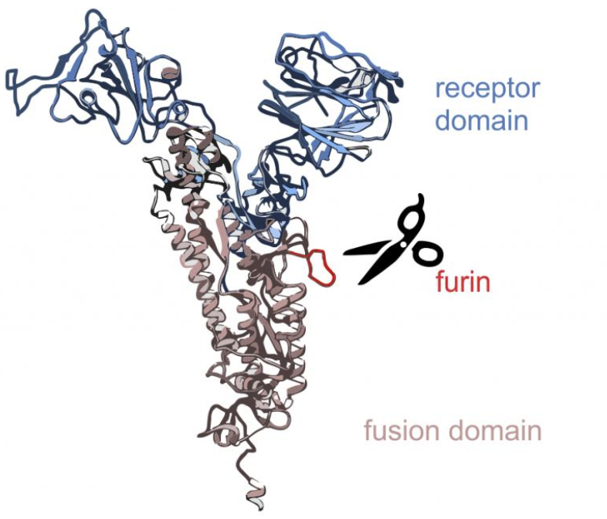
SARS-CoV-2 S1 of spike persists up to 15 months post-infection in immune cells expressing an Fcγ receptor*
S1
Enzymatic cleavage of the spike protein by furin proteases causes the S1 segment to be released and circulate freely in the vasculature
S1 is the part that binds to ACE2 receptors
S1 survives in the immune cells long after infection has cleared
Could be the cause of “long-haul COVID.”
S2
*Bruce K. Patterson et al. bioRxiv July 9, 2021. doi: 10.1101/2021.06.25.449905.
Notes:
https://www.biorxiv.org/content/10.1101/2021.06.25.449905v2
COVID_vaccines/persistance_spike_S1_15_months_post_infection.pdf
CD16 is Fc gamma receptor IIIa.

Slide 30
Pfizer Vaccine mRNA can get Converted to DNA in Human Liver Cells*
In vitro study on human liver cells
Pharmacokinetic distribution studies of Pfizer mRNA vaccines in rats showed that up to 18% of the total dose distributes to the liver
The human retrotransposon LINE-1 is a cellular endogenous reverse transcriptase, able to convert RNA to DNA.
It represents ~17% of the human genome
LINE-1 expression is elevated by the Pfizer vaccine in human cells
Vaccine-derived DNA (found in the liver cells) may be integrated into the host genome and affect the integrity of genomic DNA, which may potentially mediate genotoxic side effects
*Markus Aldén et al. Current Issues in Molecular Biology 2022, 44, 1115–1126.
Notes:
COVID_vax/Pfizer_vax_mRNA_reverse_transcribed_liver.pdf

Slide 31
“Free SARS-CoV-2 Spike Protein S1 Particles May Play a Role in the Pathogenesis of COVID-19 Infection”*
S1 molecules carry intact RBD domains, and their binding to ACE2 may induce ACE2 downregulation and deleterious downstream effects
*Andrey V. Letarov et al. Biochemistry (Moscow) 2020 Dec 30: 1–5.
Notes:
miRNAs/free_S1_spike_role_in_COVID19.pdf
Caption:
Putative involvement of free S1 subunits of the SARS-CoV-2 S protein in the COVID-19 infection. Spontaneous “firing” of the S protein trimers on the surface of virions and infected cells liberates free RBD-containing S1 particles. The binding of these S1 particles to ACE2 may cause a decrease in the ACE2 cell surface expression and lead to the RAS imbalance. (Color version of the figure is available in the online verssion of this article and can be accessed at: https://www.springer.com/journal/10541)

Slide 32
“Free SARS-CoV-2 Spike Protein S1 Particles May Play a Role in the Pathogenesis of COVID-19 Infection”*
S1 molecules carry intact RBD domains, and their binding to ACE2 may induce ACE2 downregulation and deleterious downstream effects
Eleven out of 13 health care workers had detectable levels of spike protein and/or S1 in their blood plasma as early as 1 day and up to 28 days following the first mRNA vaccine, with a peak level on average after five days.**
**Ogata et al. Clinical Infectious Diseases 2021; ciab465. [Epub ahead of print] doi: 10.1093/cid/ciab465.
*Andrey V. Letarov et al. Biochemistry (Moscow) 2020 Dec 30: 1–5.
Notes:
miRNAs/free_S1_spike_role_in_COVID19.pdf
https://academic.oup.com/cid/advance-article/doi/10.1093/cid/ciab465/6279075

Slide 33
“Free SARS-CoV-2 Spike Protein S1 Particles May Play a Role in the Pathogenesis of COVID-19 Infection”*
S1 molecules carry intact RBD domains, and their binding to ACE2 may induce ACE2 downregulation and deleterious downstream effects
S1 alone caused COVID-19-like lung symptoms in mice humanized with ACE2 receptor: Immune cell infiltration, cytokine storm, impaired barrier function.***
***Ruben M. L. Colunga Biancatelli et al.
Am J Physiol Lung Cell Mol Physiol 2021; 321: L477–L484.
*Andrey V. Letarov et al. Biochemistry (Moscow) 2020 Dec 30: 1–5.
Notes:
miRNAs/SARS_S1_causes_lung_damage_transgenic_mice.pdf

Slide 34
How Spike Protein can Cause Cardiac Issues*
Stress
Macrophage
Spike protein S1 unit causes stress and binds to ACE2 receptors, disabling them
This causes accumulation of Angiotensin II which activates macrophages
Macrophages secrete abundant exosomes containing miR-155
These exosomes are taken up by fibroblasts, suppressing their proliferation
This interferes with the healing process, leading to cardiac rupture
Exosome
Secretion
Cardiac Fibroblast
Cardiac Rupture
*Chunxiao Wang et al. Molecular Therapy 2017; 25(1): 192-204.
Notes:
blogposts/miRNAs/exosomes_with_miR-155_cardiac_inflammation.pdf

Slide 35
How Spike Protein can Cause Cardiac Issues*
Stress
Macrophage
Spike-protein "pseudoviruses" cause endothelial damage by downregulating ACE2**
**Yuyang Lei et al. Circulation Research 2021; 128: 1323-1326.
Spike protein S1 unit causes stress and binds to ACE2 receptors, disabling them
This causes accumulation of Angiotensin II which activates macrophages
Macrophages secrete abundant exosomes containing miR-155
These exosomes are taken up by fibroblasts, suppressing their proliferation
This interferes with the healing process, leading to cardiac rupture
Exosome
Secretion
Cardiac Fibroblast
Cardiac Rupture
*Chunxiao Wang et al. Molecular Therapy 2017; 25(1): 192-204.
Notes:
blogposts/miRNAs/exosomes_with_miR-155_cardiac_inflammation.pdf

Slide 36
miR-155 overexpression linked to worse outcomes in heart attack*
MI1: heart attack within first 24 hours of clinical symptoms
MI2: heart attack 2-7 days after onset of clinical symptoms
Measured three miRNA levels in autopsy samples of 50 patients with MI
“innate immunity resulting in an intense inflammatory reaction plays an important role in the pathogenesis of the VR [ventricular rupture] after MI [myocardial infarction] in humans.”
*Figure 1. Nina Zidar et al. Disease Markers 2011; 31: 259-265.
Notes:
blogposts/miRNAs./miRNA_155_in_heart_attack_ventricular_rupture_2011.pdf

Slide 37
VAERS Reports involving heart issues in 2021*
Symptom | Covid-19 Vaccines | All Vaccines | Percent COVID-19
Myocarditis | 2,322 | 2,361 | 98.3
Cardiac Arrest | 1,319 | 1,371 | 96.2
Arrhythmia | 1,069 | 1,087 | 98.3
Myocardial Infarction | 2,224 | 2,272 | 97.9
Cardiac Failure | 1,156 | 1,190 | 97.1
Tachycardia | 6,743 | 6,890 | 97.9
Cardiomyopathy | 330 | 337 | 97.9
Total | 15,163 | 15,580 | 97.7
*Analyses from http://wonder.cdc.gov/vaers.html

Slide 38
Myocarditis Reports in VAERS*
Sweden, Finland and Denmark have decided to pause the use of the Moderna vaccine for boys and men under 30
Through September 24, 2021
16-and-over vaccination began December 14, 2020
12-15-year-old vaccination began May 10, 2021
*https://openvaers.com/covid-data/myo-pericarditis

Slide 39
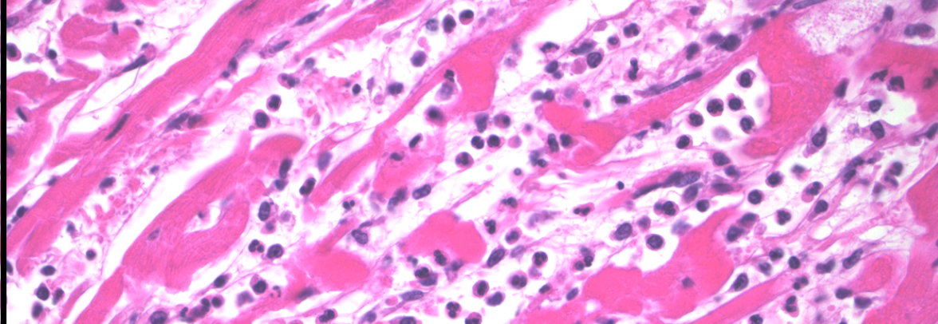
“Autopsy Histopathologic Cardiac Findings in Two Adolescents Following the Second COVID-19 Vaccine Dose”*
Two teenage boys were found dead in bed 3 and 4 days after receiving the second dose of the Pfizer-BioNTech COVID-19 vaccine
Neither boy complained of fever, chest pain, palpitations, or dyspnea (difficulty breathing)
Unique cardiac findings in Boy A included myocardial fibrosis (scarring) and in Boy B cardiac hypertrophy (enlarged heart)
Neither boy was positive for SARS-CoV-2
*JR Gill et al. Arch Pathol Lab Med 2022 Feb 14. [Epub ahead of print] doi: 10.5858/arpa.2021-0435-SA
Notes:
COVID_vax/myocarditis_death_teenage_boys_post_COVID_jab.pdf

Slide 40
Spike Protein and Cancer

Slide 41
"Mechanistically, we found that the spike protein localizes in the nucleus and inhibits DNA damage repair by impeding key DNA repair protein BRCA1 and 53BP1 recruitment to the damage site.”*
*Hui Jiang and Ya-Fang Mei, Viruses 2021; 13: 2056.

Slide 42
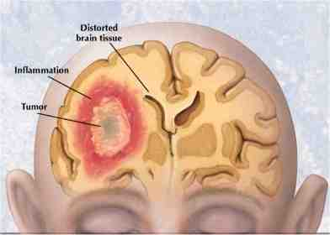
Glioblastoma and Other Cancers
Glioblastoma is the most aggressive form of brain cancer
microRNA-148a is linked to bad outcomes*
High levels were a risk indicator for shortened life span in glioblastoma patients
Increased cell growth, survival, migration, and invasion
MicroRNA‐590‐3p enhances the radioresistance in glioblastoma cells**
miR-590-3p expression was higher in high grade than in low grade gliomas
miRNA-590 overexpression is also linked to breast cancer, cervical cancer, clear cell renal carcinoma and hepatocellular carcinoma
*Jungeun Kim et al. Cancer Res. 2014 March 1; 74(5): 1541–1553.
**Long Chen et al. Experimental and Therapeutic Medicine 2017; 14: 1818-1824.
Notes:
miRNA/exosomes_of_glioma_cells_deliver_miR-148a_promote_glioblastoma_target_CADm1.pdf
cancer/miRNA-148a_in_glioblastoma_2014.pdf

Slide 43
VAERS reports: Total counts for various terms indicating cancer from 2021*
Symptom | Counts COVID-19 vaccines | Counts All Vaccines | Percent COVID-19
Cancer | 396 | 403 | 98.3
Lymphoma | 144 | 153 | 94.1
Leukaemia | 155 | 161 | 96.3
Metastatic/metastasis | 175 | 179 | 97.8
Carcinoma | 176 | 187 | 94.1
Neoplasm | 428 | 452 | 94.7
TOTAL | 1,474 | 1,535 | 96.0
*http://wonder.cdc.gov/vaers.html

Slide 44
Spike Protein and Thrombosis

Slide 45
The mRNA in the vaccines is long-lasting and induces strong IgG response*
Lymph nodes of vaccine recipients show abundant germinal centers
Vaccination induces stronger IgG response than the disease
The mRNA from the vaccines and spike proteins remain in germinal centers in lymph nodes for up to 60 days
A strong IgG response can lead to platelet activation and blood clots!!
*Katharina Röltgen et al. Cell January 25, 2022 [Epub ahead of print]. https://doi.org/10.1016/j.cell.2022.01.018
Notes:
https://www.sciencedirect.com/science/article/pii/S0092867422000769

Slide 46
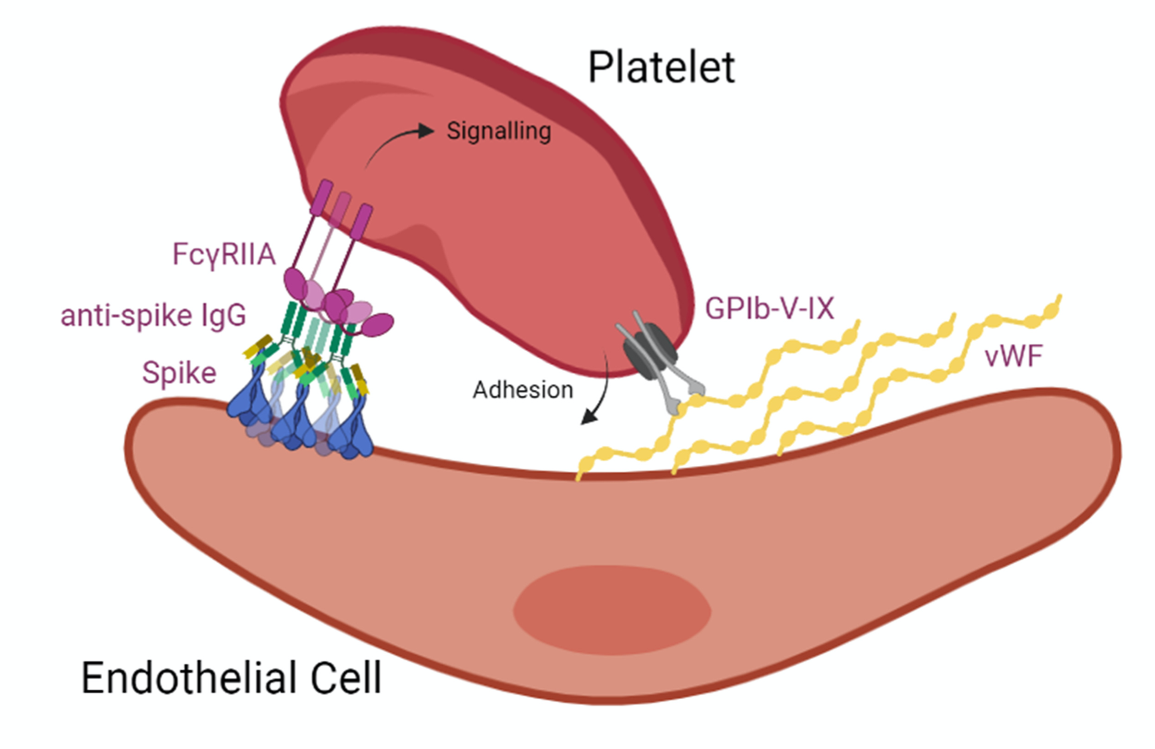
Thrombocytopenia & miR-148a*
Platelets have an Fcγ receptor for the constant fragment of immunoglobulin G (IgG) in antigen-antibody complexes
Receptor activation leads to platelet activation, aggregation and thrombosis
TULA-2 (T-cell ubiquitin ligand-2) suppresses platelet activation
It inhibits the platelet Fcγ receptor and protects from thrombocytopenia
miR-148a targets TULA-2 mRNA and downregulates TULA-2 protein expression
CONCLUSION: miR-148a overexpression can lead to heparin-induced thrombocytopenia (in the absence of heparin)
*Yuhang Zhou et al. Blood 2015; 126(26): 2871–2881.
Notes:
miRNAs/thrombocytopenia.text
Figure 5 in
COVID_vaccines/aberrant_glycosylation_IgG_platelets_Fc_thrombosis.pdf (diagram)

Slide 47
Thrombocytopenia & miR-148a*
Platelets have an Fcγ receptor for the constant fragment of immunoglobulin G (IgG) in antigen-antibody complexes
Receptor activation leads to platelet activation, aggregation and thrombosis
TULA-2 (T-cell ubiquitin ligand-2) suppresses platelet activation
It inhibits the platelet Fcγ receptor and protects from thrombocytopenia
miR-148a targets TULA-2 mRNA and downregulates TULA-2 protein expression
CONCLUSION: miR-148a overexpression can lead to heparin-induced thrombocytopenia (in the absence of heparin)
Higher expression of miR-155 in peripheral blood monocytes of immune thrombocytopenia patients also correlated positively with the reduction in platelet count.*
*BH Qian et al. Acta Haematol 2015; 133(3): 257-63.
*Yuhang Zhou et al. Blood 2015; 126(26): 2871–2881.
Notes:
miRNAs/thrombocytopenia.text
Figure 5 in
COVID_vaccines/aberrant_glycosylation_IgG_platelets_Fc_thrombosis.pdf (diagram)

Slide 48
A role for miRNA-155 in SARS-CoV-2*
“Small RNA profiling showed strong expression of the immunity and inflammation-associated microRNA miRNA-155 upon infection with both viruses” (SARS-CoV and SARS-CoV-2)
“SARS-CoV-2 elicited approximately two-fold higher stimulation of the interferon response compared to SARS-CoV …, and induction of cytokines such as CXCL10 or IL6.”
Interferon-γ upregulates miR-155**
*Wyler Emanuel et al. bioRxiv preprint. May 5, 2020.
doi: https://doi.org/10.1101/2020.05.05.079194.
**Yu-An Hsu et al. Chin J Physiol 2016; 59(6): 315-322.
Notes:
COVID_vaccine/SARS-CoV-2_and_miR-155.pdf
**:
https://pubmed.ncbi.nlm.nih.gov/27817193/

Slide 49
Various types of thrombosis: VAERS reports in 2021
Symptom | Covid-19 Vaccines | All Vaccines | Percent COVID-19
Thrombosis | 3,899 | 3,951 | 98.7
Deep vein thrombosis | 2,275 | 2,297 | 99.0
Pulmonary thrombosis | 631 | 646 | 97.7
Cerebral thrombosis | 211 | 215 | 98.1
Portal vein thrombosis | 89 | 90 | 98.9
Superficial vein thrombosis | 81 | 81 | 100
Peripheral artery thrombosis | 74 | 74 | 100
Mesenteric vein thrombosis | 55 | 56 | 98.2
Venous thrombosis | 41 | 41 | 100
TOTAL | 7,356 | 7,451 | 98.7
Pulmonary embolism | 3,100 | 3,137 | 98.8
*US Vaccine Adverse Event Reporting System: http://wonder.cdc.gov/vaers.html

Slide 50
Spike Antibodies and Autoimmune Disease

Slide 51
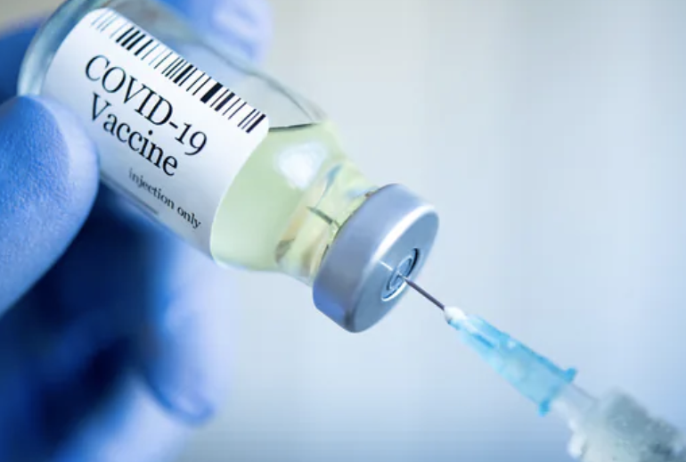
“Substantial Differences in SARS-CoV-2 Antibody Responses Elicited by Natural Infection and mRNA Vaccination”*
After the second dose of the vaccine, antibody titers were up to 10 times higher than those of patients who had recovered from natural COVID-19 infection.
This does not mean that the vaccinated people are better protected than those who recovered from the disease
High antibody titers opens you up for autoimmune disease, especially when miR-148a is overexpressed
*Rafael Assis et al. bioRxiv preprint. May 19, 2021. doi: https://doi.org/10.1101/2021.04.15.440089
Notes:
https://www.contagionlive.com/view/immune-response-from-mrna-covid-19-vaccines-is-more-robust-than-natural-infection

Slide 52
“Potential antigenic cross-reactivity between SARS-CoV-2 and human tissue with a possible link to an increase in autoimmune diseases”*
Cross reaction between spike protein antibody and tissue proteins
Protein/organelle Diseases
transglutaminase Celiac disease
extractable nuclear antigens Scleroderma, lupus
myelin basic protein Multiple sclerosis, autism
mitochondria Lupus, primary billiary cirrhosis, hepatitis, myocarditis
nuclear antigen Sjogren's syndrome, mixed connective tissue disease, lupus
myosin Myocarditis, dilated cardiomyopathy, Chagas' heart disease, Kawasaki disease, rheumatic fever
thyroid peroxidase Hashimoto's thyroid disease
S100B Brain metastases from lung disease, epilepsy, multiple sclerosis, and Parkinson's disease
*Aristo Vojdani and Datis Kharrazian, Clinical Immunology 217 (2020) 108480.
Notes:
https://www.ncbi.nlm.nih.gov/pmc/articles/PMC7246018/
COVID/cross_reactivity_spike_protein_human_proteins.pdf
Commercially available mouse monoclonal antibody made against recombinant SARS coronavirus spike protein a

Slide 53
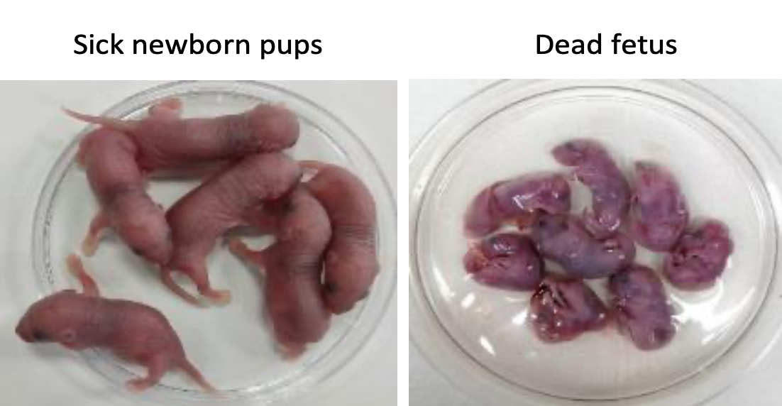
“Pathogenic antibodies induced by spike proteins of COVID-19 and SARS-CoV viruses”*
REGN10987 is a neutralizing IgG antibody produced in response to the spike protein
Researchers injected the antibody into the peritoneum of pregnant rats
The offspring of the pregnancy were highly damaged:
Acute renal tubular injury
Myocardial hemorrhage (heart damage)
Inflammation in the brain
Many were born dead
Antibody also bound broadly to human inflammatory tissues or cancer tissues, likely increasing the severity of preexisting disease
*Huiru Wang et al. Research Square Jun 17, 2021. DOI: 10.21203/rs.3.rs-612103/v2.
Notes:
COVID_vaccine/Hangzhou_China_study_S1_antibodies_toxic_to_fetus_mice_WOW.pdf
SARS-CoV-2_neutralizing_antibodies_REGN10987.pdf

Slide 54
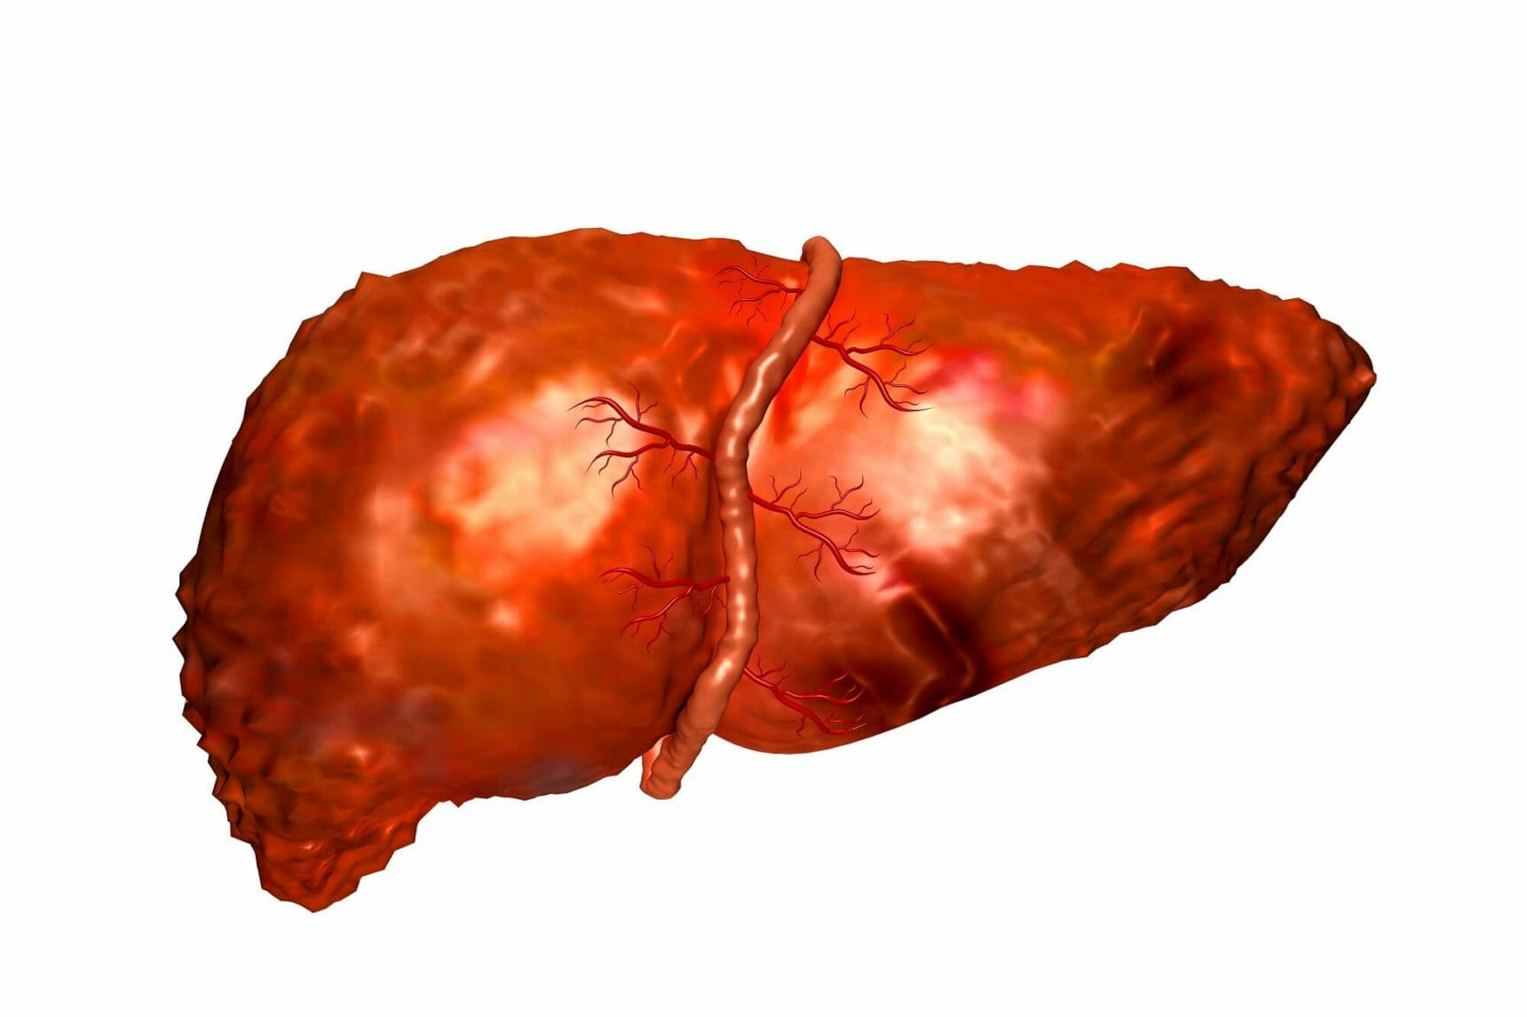
Autoimmune Hepatitis Following COVID-19 Vaccine: Two Case Studies
35-year-old woman developed autoimmune hepatitis one week post-COVID-19 vaccination (Pfizer) associated with antinuclear antibodies*
71-year-old woman noticed jaundice four days post-vaccination with Moderna vaccine**
Total IgG was markedly raised at 21.77g/L
Massive eosinophil infiltration typical of drug-induced liver injury
Liver enzymes elevated
Liver injury has been linked to COVID-19 as well***
*Fernando Bril et al. Journal of Hepatology 2021; 75: 221-255
**Cathy McShane et al. Journal of Hepatology July 7, 2021 (Epub ahead of print] DOI: 10.1016/j.jhep.2021.06.044
***Jose D Debes et al. Dig Liver Dis. 2020; 52(9): 953-955.
Notes:
miRNA/autoimmune_hepatitis_after_COVID_vaccine.pdf

Slide 55
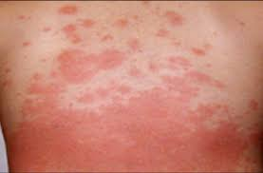
Adult-onset Still's disease after mRNA COVID-19 vaccine*
Still's disease is a rare multisystem inflammatory disorder that mostly affects young adults (16–35 years)
Case study: 45-year-old previously healthy woman
Severe adult-onset Still's disease (an autoimmune disease) following mRNA vaccination
Onset of symptoms was 5 days following the second dose
Symptoms included severely debilitating muscle aches and pains, joint stiffness, and pleuritis (inflammation in lungs)
*D Magliulo et al. The Lancet Rheumatology 2021; 3(1): E680-E682.
Notes:
COVID_vax/Stills_disease_autoimmune.pdf

Slide 56
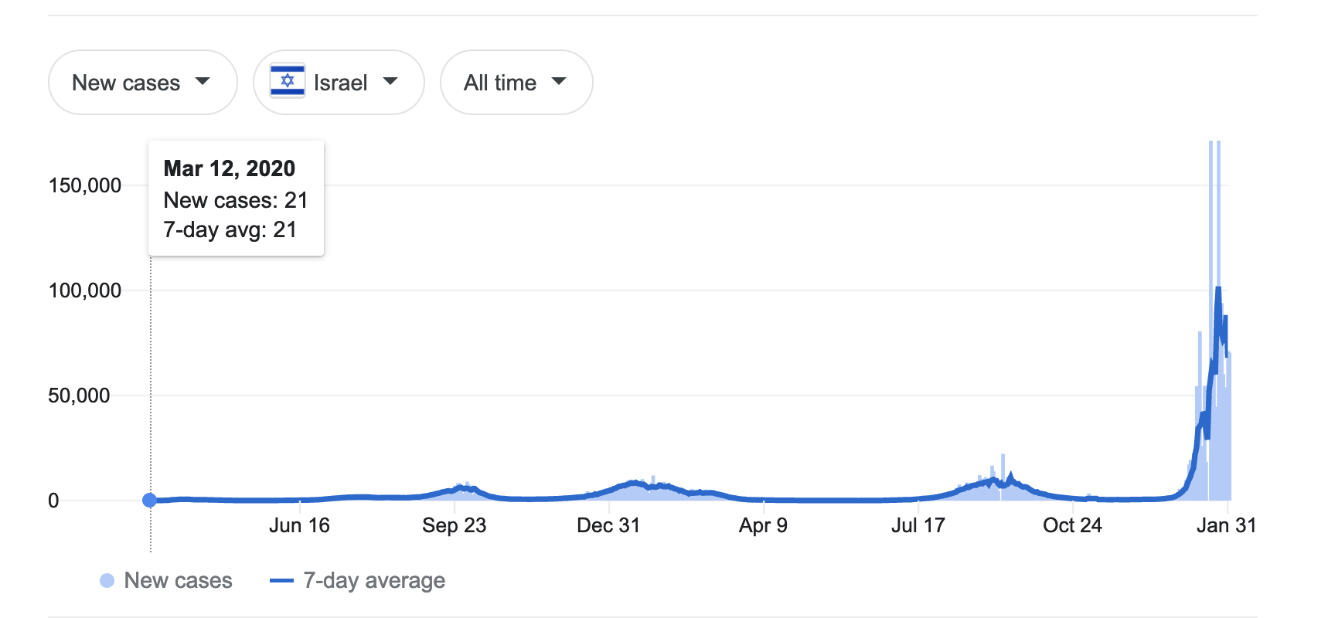
Israel world #1 in daily COVID cases per capita, January 20, 2022
The vaccines are not stopping the spread of COVID-19
Israel is one of the most highly vaccinated countries in the world

Slide 57
Summary
The mRNA vaccines are carefully crafted to induce immune cells to produce large quantities of the SARS-CoV-2 spike protein
The spike protein is toxic and has prion-like characteristics
The vaccines produce a very strong antibody response in the spleen by activating germinal centers, and this increases susceptibility to neurodegenerative disease and autoimmune disease
Exosomes traveling from the spleen to the brain may play a decisive role
Spike causes an inflammatory response in the brain, heart and vasculature
There is much evidence from VAERS of mRNA vaccines causing neurodegenerative disease, cardiovascular disease, thrombosis and cancer
The vaccines lose their effectiveness against the disease over time, especially with the emergence of variants

