Slide 1
Quality Investigation of Vaccines
Dr. Loretta bolgan

Slide 2
Purpose of the Investigation
Compliance assessment of the composition as indicated in the vaccine data sheet
Screening of chemical, protein / peptide contamination and genetic material
Target compound confirmation (chemicals and proteins) with certified standard
controls
Interlaboratory confirmation analysis

Slide 3
Technologies
The study commissioned by Corvelva was based on two types of analysis:
GENETIC MATERIAL ANALYSIS
Test for the presence of nucleic acids (DNA/RNA) of human and animal origin and of microorganisms (viruses, bacteria) using the Next Generation Sequencing method, which allowed to quantify the sequence of the genetic material contained in the vaccines examined in a highly specific and accurate manner.
Verification of the correspondence of the genome sequences of live attenuated or inactivated bacteria and viruses present in the vaccines (presence of genetic variants)

Slide 4
Technologies
ANALYSIS OF CHEMICAL AND PROTEIN IMPURITIES AND CONTAMINATION
The examination of military vaccine registration dossiers revealed the presence of chemical and protein contamination and impurities, which required further analytical analysis.
It has been therefore necessary to develop a technology capable of analyzing a wide spectrum of molecules of chemical, metabolic and protein origin in order to evaluate the quality of the obtained results.
The LC-SACI/ESI-MS analysis system associated with the innovative SANIST platform was used to perform a first identification screening on the vaccines of interest.

Slide 5
Investigated vaccines
INFANRIX HEXA GlaxoSmithKline Biologicals s.a.
Diphteria vaccine (adsorbed) (D), antitetanic (T), antipertussis (acellular component) (Pa), anti-hepatitis B (rDNA) (HBV), antipoliomyelitic (inactivated) (IPV) and conjugate anti-Haemophilus influenzae type b (Hib).
Powder and suspension for suspension for injection.
PRIORIX TETRA GlaxoSmithKline S.p.A.
Live attenuated measles, mumps, rubella and varicella vaccine.
HEXYON Sanofi Pasteur Europe
Diphtheria, tetanus, pertussis (acellular, component), hepatitis B (rDNA), poliomyelitis (inactivated) and Haemophilus influenzae type b conjugate vaccine (adsorbed).
suspension for injection in pre-filled syring
GARDASIL 9 MSD VACCINS
Human Papillomavirus 9-valent Vaccine (Recombinant, adsorbed)
L1 Protein from the type 6, 11, 16, 18, 31, 33, 45, 52, 58

Slide 6
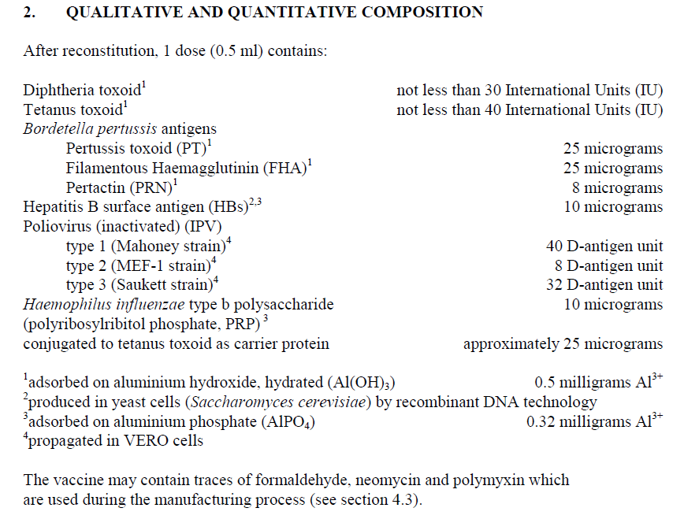
Infanrix hexa
Preservative
2-phenoxyethanol 2.5mg/dose
(Scientific discussion EMA)

Slide 7
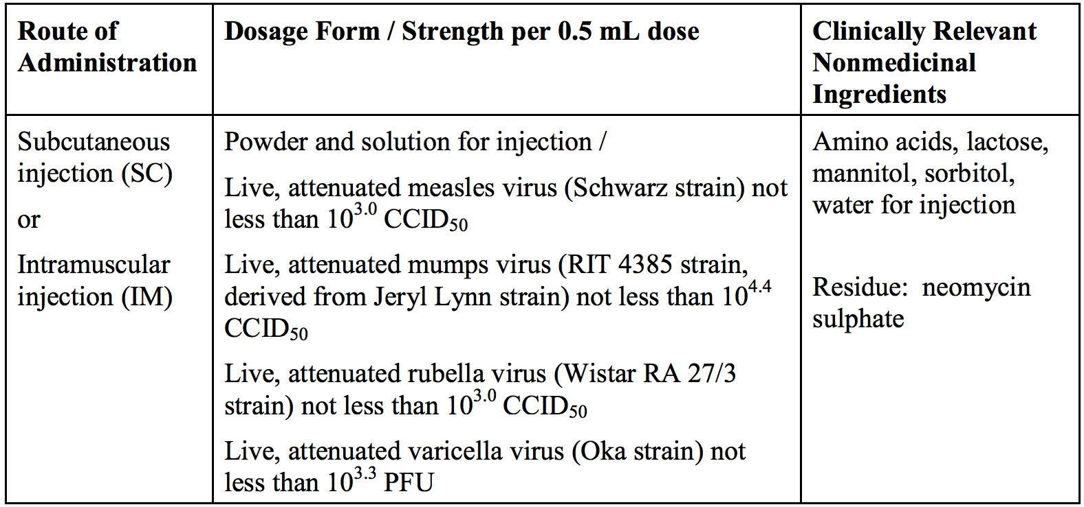
Priorix tetra
The measles virus and the mumps virus is obtained by propagation in chick embryo tissue cultures;
the rubella virus and varicella virus are propagated in MRC-5 human diploid cells.
The MRC-5 cell line was derived from normal lung tissue of a 14-week-old male fetus in 1966; the cells are capable of 42 to 46 population doublings before the onset of senescence.

Slide 8
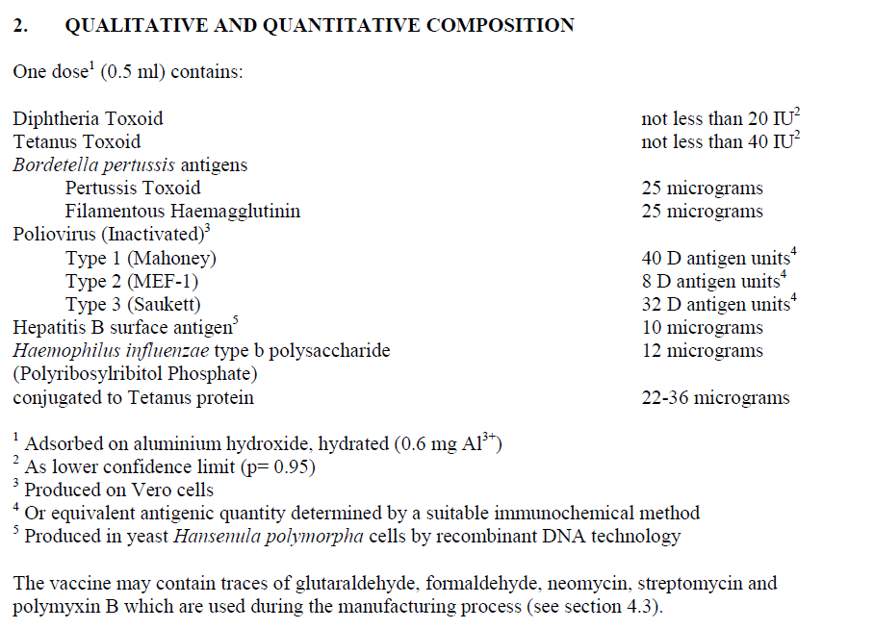
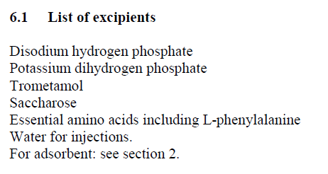
Hexyon

Slide 9
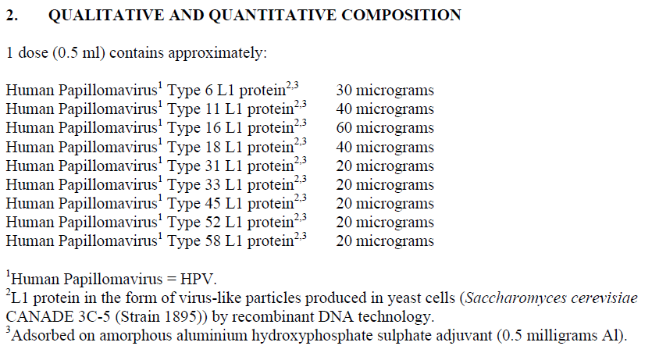
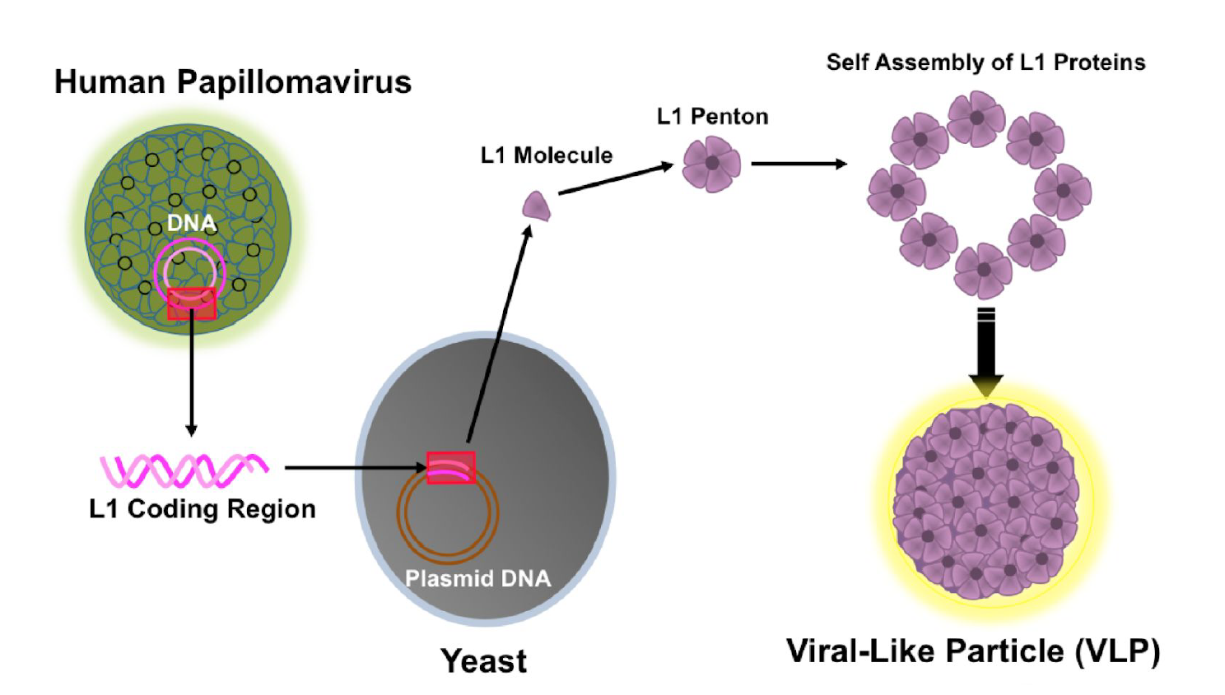
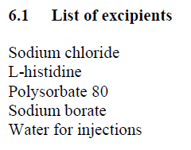
Gardasil 9

Slide 10
Results of analysis | Infanrix hexa | Hexyon | Priorix tetra | Gardasil 9
Antigens | Protein antigens have not been identified. Presence of an insoluble and indigestible macromolecule that could not be sequenced. MALDI-TOF analysis of the macromolecule: it was not possible to study it because it included the analysis matrix. "Prion" behavior? | 3 out of 6 protein antigens were identified and sequenced. "Prion" behavior? (the antigens aggregate and fall over time becoming insoluble) | 3 of the 4 attenuated viruses were identified and sequenced. Rubella was detected in a very low number of copies. Varicella, mumps and measles viruses present major mutations probably acquired during attenuation a large number of minor variants (quasispecies) | 7 of the 9 protein antigens were identified. (strains 11 and 58 are missing) "Prion" behavior? (the antigens aggregate and fall over time becoming insoluble)
Chemical contaminants (signals) | 65 (35% known) PEG, formic acid | 216 (30% known) | 115-173 (29-43% known | 338 (22% known)
Chemical toxins | 8 | 16 | no | 10
Protein contaminants | no | no | Sarcoplasmin calcium-binding protein, Actina e Vimentina | no
Free peptide contaminants | 16 | no | no | no
Residual DNA / RNA Coming from the culture cells | Below the limits of detection of the instrument with standard fluorimetric methods (sensitivity limit 0.1 ng/μl) Monkey 4.69% (sensitivity library DNA-seq kit 10 pg) | DNA 6.88 ng; RNA 100.8 ng; DNA and RNA from bacterial cultures. DNA / RNA of monkeys (Vero cells) and primates. Poliovirus 1 and 2 The material found was in traces and degraded | Total DNA: 1.7-3.7 µg / dose of which 80% human (human fetal DNA / RNA from the MRC-5 cell line). Other DNA: chicken | DNA below the limits of detection of the instrument with standard fluorimetric methods (sensitivity limit 0.1 ng/μl) Human and mouse DNA (in traces) RNA 8.732 ng
Adventitious viruses | no | Tetanus phage Vectors used for cloning | Human endogenous retrovirus K Avian leukosis virus HERV-H/env62 | Molluscum contagious virus (Myoviridae) Fagi Retrovirus (DNA): Murine leukemia virus Human endogenous retrovirus K Retrovirus (RNA): Murine leukemia virus
Other microbial contaminants | no | no | no | Saccharomyces and its viruses
Processing residues of genetic material | no | no | no | DNA: L1 fragments (missing the 58 strain; presence 20) The L1 18, 16, 6 (RNA) fragments were sequenced
Metals | Aluminum equal to 723.5 μg ± 130 μg / dose Other metals below 5ng / dose | Aluminum 546 μg ± 98.5 μg / dose Other metals below 5ng / dose | Aluminum equal to 0.8 μg ± 0.15 μg / dose Other metals below 5ng / dose | Aluminum equal to 416 μg ± 75 μg / dose Other metals below 5ng / dose
*

Slide 11
UPDATES
STUDY OF MACRO-MOLECULE IN THE INFANRIX VACCINE HEXA WITH MALDI-TOF-MS
STUDY OF THE QUASISPECIE IN THE PRIORIX TETRA VACCINE
STUDY OF L1 SEQUENCES IN THE GARDASIL VACCINE 9
QUANTITATIVE ANALYSIS OF METALS BY ICP-MS
SECOND-LEVEL SCREENING OF THE UNKNOWN PART
IN PROGRESS
GENOMA SEQUENCING OF MRC-5 FETAL CELLS
INTERLABORATORY ANALYSIS
SCHEDULED
STUDY OF ALLUMINUM-BOUND ANTIGENS (PRIONS)
STUDY OF THE SEQUENCE HOMOLOGY BETWEEN VACCINE ANTIGENS AND HOST PROTEINS (PRIONS), HOST VIRUSES (PHAGES, HERVs)
STUDY OF THE QUASISPECIE OF OTHER VACCINES (MMR AND MMRV) AND MORE BATCHES
STUDY OF THE POTENCY OF ANTIGENS IN VITRO AND IN VIVO

Slide 12
UPDATE MALDI-TOF-MS
From the analyzes performed it was not possible to identify the compound but to detect some chemical-physical properties to pay attention to:
Insolubility of the compound in polar media;
Potential ability of the compound to aggregate and sequester organic nature analytes;
Non-volatile compound even if irradiated with MALDI laser light.
The characteristics mentioned above are typical of different compounds including:
Functionalized resins (used for example in the variant of the MALDI technology called SELDI, due to their property of not vaporising under the emission of laser light);
Macromolecular compounds with altered, aggregated and retentive conformation (insoluble with high resistance to digestion eg: prions);

Slide 13
UPDATE THE QUASI-SPECIES
In the vaccine VARICELLA GENOME 245 variants have been identified with respect to the reference genome used for the analysis (wild genome of the Dumas strain). Of these variants, 154 are ‘major' variants of the wild virus supported by the totality of the sequences that cover the polymorphic site, while the remaining 91 are minor variants (minority variants), that is sites that show, with respect to the reference genome, a mutation with frequency below 100% (generally between 1% and 80%).
There is no difference between the variants found in the two lots, because chickenpox is a DNA virus with a lower mutation frequency.
To understand more clearly what is meant by a minor variant, here is a simple example:
polymorphic site G
MAJOR VARIANT
ACTGTACGTTTTAGTC Reference Genoma
ACTGTACATTTTAGTC 100% of the sequences have A
MINOR VARIANT
ACTGTACGTTTTAGTC Reference Genoma
ACTGTACGTTTTAGTC 80% of the sequences have G as the reference genoma
ACTGTACCTTTTAGTC 20% of the sequences have C

Slide 14
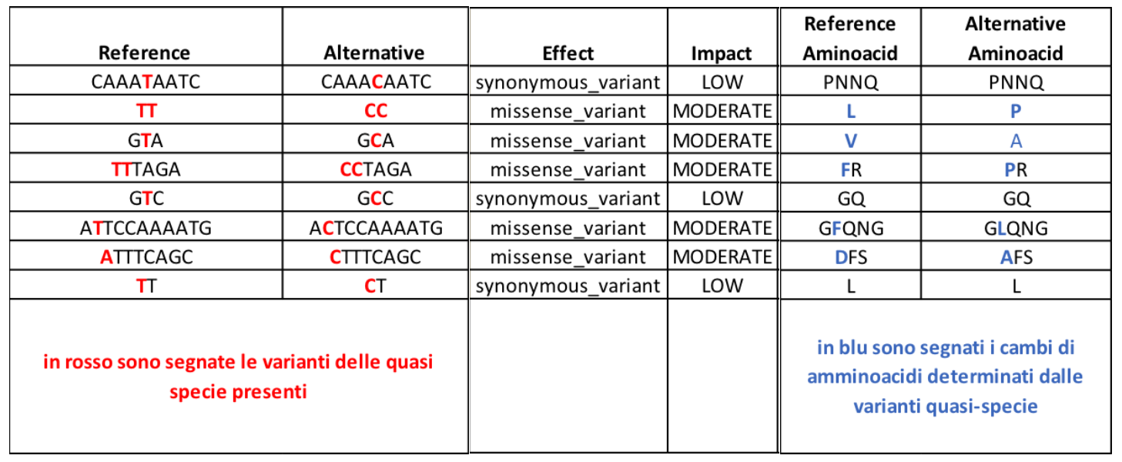
In the MUMPS VACCINE GENOME, 40 minor variants have been identified with respect to the reference genome used for the analysis (Jeryl-Lynn vaccine genome), most of them located in the NP gene (nucleocapsid protein) and having a low impact on the protein (variants synonymous, that is, that do not lead to an aminoacidic change) or moderate ('missense' variants that lead to an aminoacid change, or to non-synonymous mutations) in the encoded protein
From the comparison between the minor variants of the mumps found in the two lots, 4 differences emerge. This means that RNA viruses are able to change rapidly, in an uncontrollable way and that different lots can have different species!

Slide 15
Update
The study in metagenomics of the L1 fragments of the vaccine HPV strains reveales that strain 58 is absent both as DNA and as RNA, this may be due to the same reasons for which the protein is not found, as also the DNA and RNA sequencing could be hampered by the bond with aluminum (as demonstrated in Professor Lee's studies), or indeed the antigen might be missing. The absence of DNA and the presence of RNA for types 16, 6, 11, 33, 52, 45, 31 indicates that the strains are present and there is also a finding in the analysis by LC-MS with protein detection, except for strain 11. Strain 20 is not stated in the data sheet, therefore it can be considered a potential contaminant. Virus copies designated as Human papilllomavirus and Unsigned Papillomaviridae are pieces of the L1 fragments that cannot be attributed to a specific strain. For further information, the L1 fragments present in the greatest number of copies, ie strains 18, 16 and 6, were sequenced and thus they were confirmed. The implications related to the presence of these fragments are those already reported by Prof, Lee in his publications, namely the presence of aluminum stabilizes degradation, enhancing the ability to activate a powerful long-term inflammatory response and to be transported through the lymphatic system inside macrophages to various organs of the body

Slide 16
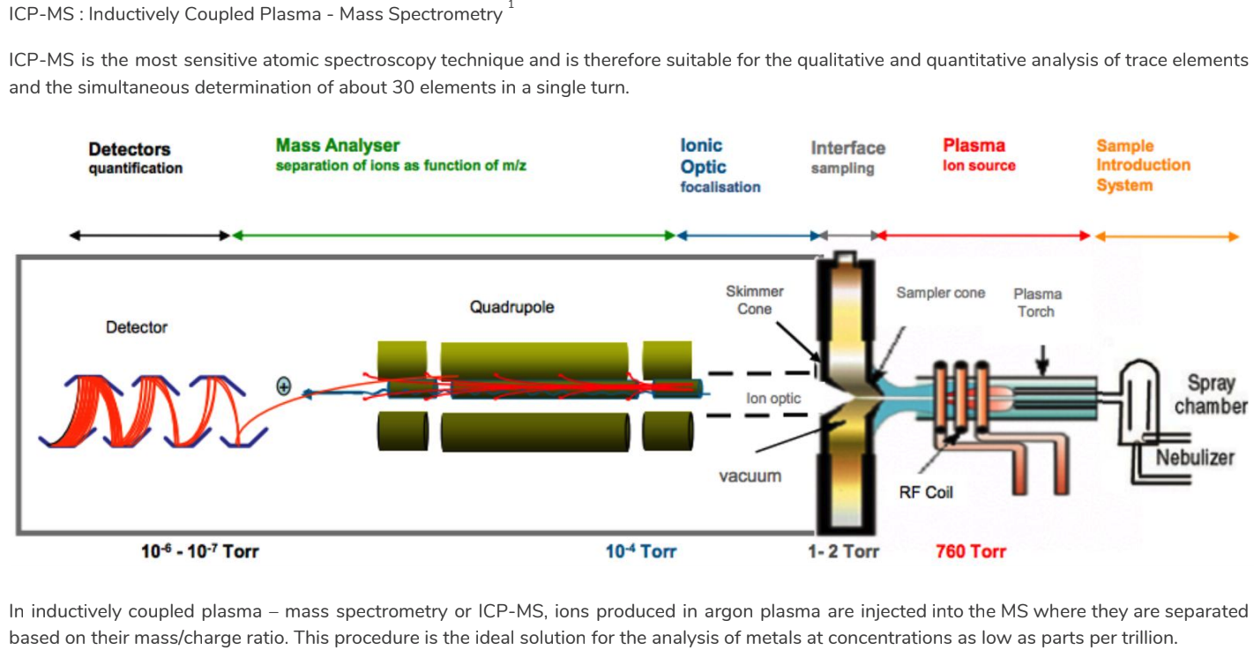
Update Quantitative Metal analysis by ICP-MS

Slide 17
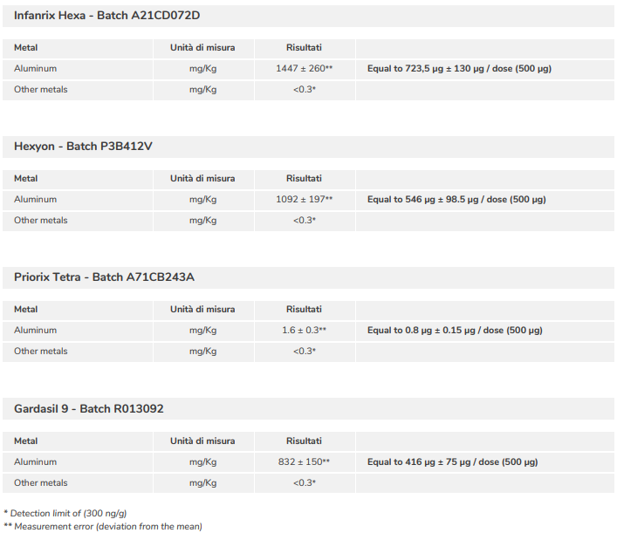
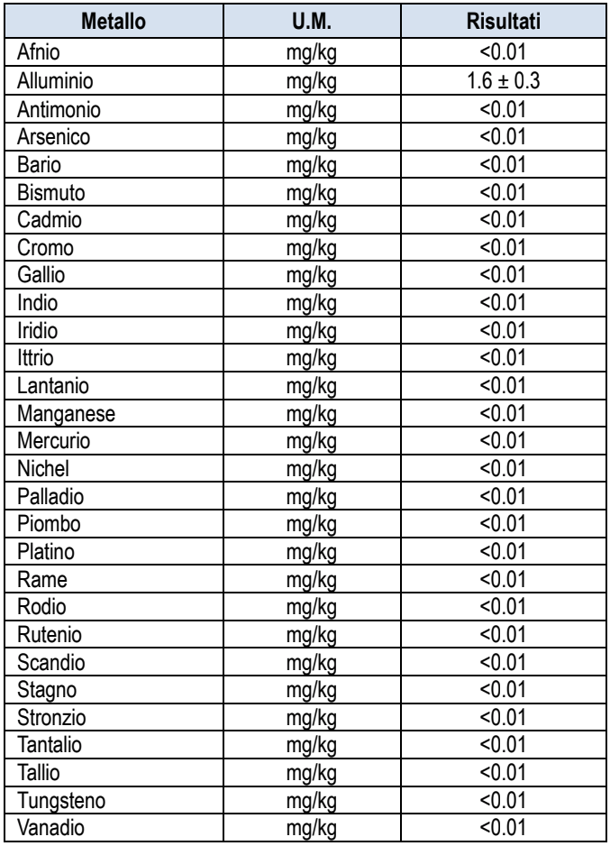
Update
Last Cut-off = 0.01mg/kg = 5 ng/dose
Priorix tetra

Slide 18
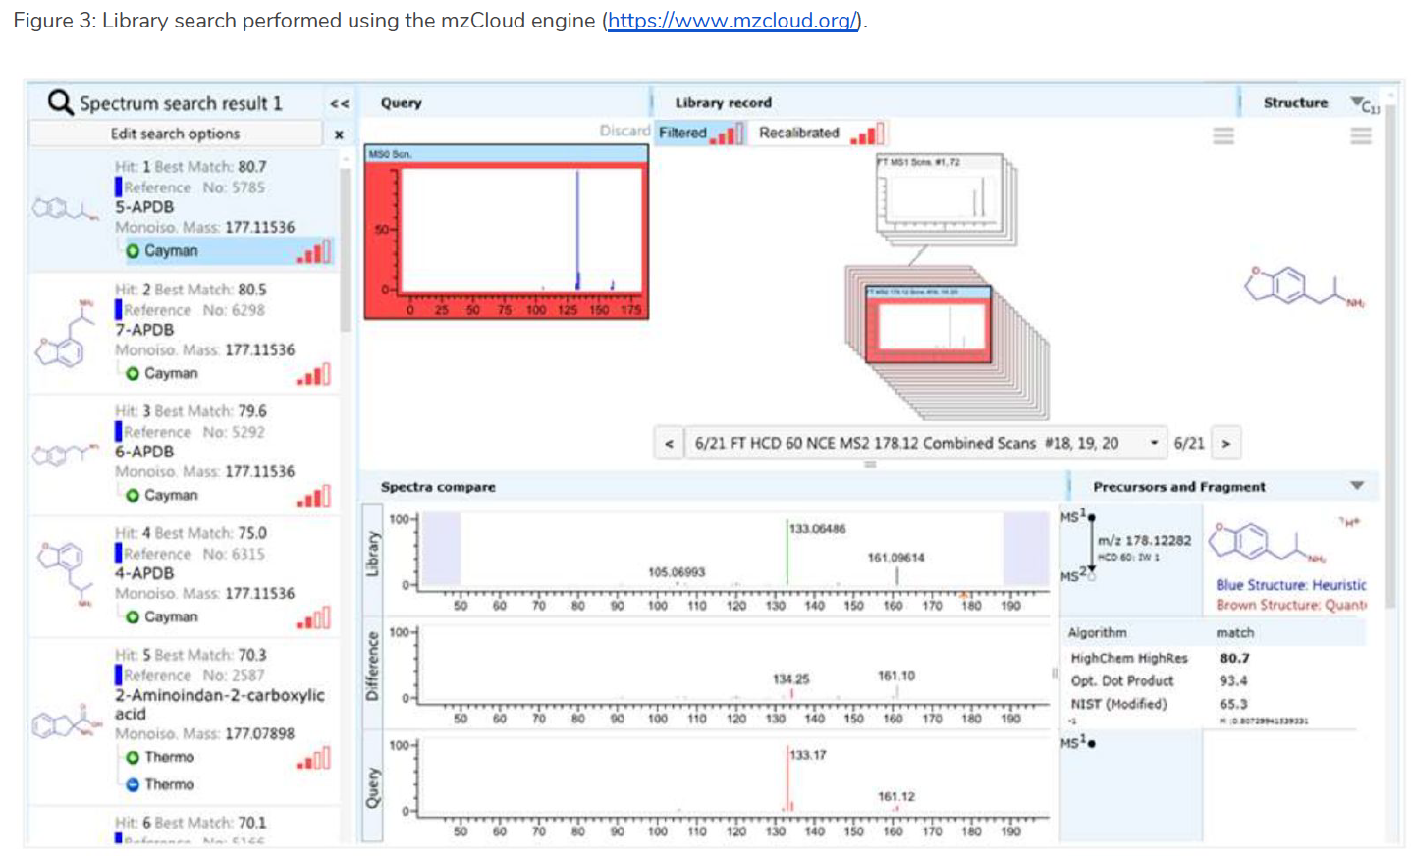
UPDATE SECOND-LEVEL SCREENING by LC-MS
in lot R009338 OF GARDASIL 9, there is a contamination corresponding to an illegal drug named "APDB” of the amphetamine class

Slide 19
Relevance of the results obtained
THE ANALYZED PRODUCTS PRESENT DIFFERENT CRITICISM THAT REQUIRES AN ANSWER BY REGULATORY AGENCIES AND RELATIVE PRODUCERS:
the non-identification / presence below the threshold of vaccine antigens (efficacy?)
The presence of chemical and protein / peptide contaminations identified in non-residual and high numbers (cumulative dose toxicity?)
The presence of a high percentage of unidentified chemical and protein / peptide contamination (application of the precautionary principle?)
The presence of processing residues in non-residual quantities with potential negative effects on human DNA (fetal DNA) and adventitious viruses that must be absent (long-term safety?)
IF YOU CAN NOT GUARANTEE THE QUALITY OF A DRUG YOU CANNOT GUARANTEE EFFECTIVENESS AND SAFETY!

Slide 20
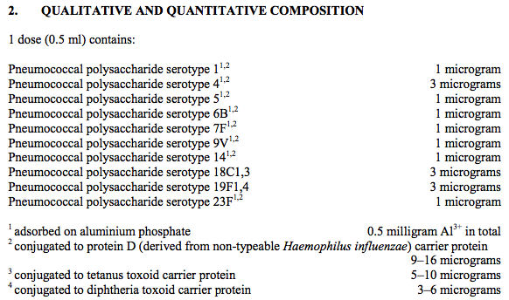
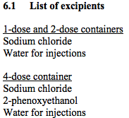
Quality investigation on Synflorix

Slide 21
Results
The results show the following:
It was not possible to identify the active ingredients of the vaccine, ie the 10 conjugated vaccine antigens.
The presence of an insoluble and indigestible aggregate (called "macromolecule") was found
From the quantitative analysis with the Bradford test the protein concentration is about 0.25 mg / mL (125 micrograms / dose), ie higher than the sum of the quantity of antigens. It follows that in the vaccine there are probably other protein contaminations coming from the production process or from the raw materials used
two contaminating proteins have been identified:
the nuclear protein of the EBNA-1 virus
the acetylcholinesterase
chemical contamination: presence of the polyethylene glycol polymer
contamination of adventitious genetic material: none

Slide 22
Risk for the health
The macromolecule is composed by an insoluble and indigestible aggregate between the antigens and the aluminum adjuvant. It can constitute a health risk because it could remain deposited at the injection site and stimulate a prolonged inflammatory response, as the bond with aluminum can make the antigens particularly stable to degradation also in vivo
the prolonged inflammatory state is associated with the increased risk of autoimmune diseases, and when the antibodies that form after vaccination cross-react against specific human proteins present in the brain, very serious neurological damage occurs.
The aluminum adjuvant can be transported from the injection site to other parts of the body by macrophages with particularly harmful effects, if it can reach the brain. Since in this case aluminum is chemically bound to antigens, it can be hypothesized that antigens are also transported and deposited in other districts together with aluminum with possible inflammatory / autoimmune reactions.

Slide 23
Risk for the health
The EBNA-1 nuclear protein of Epstein-Barr virus is a contamination of unknown origin. Given its ability to interact and modify cellular DNA,
the EBNA-1 protein is involved in the process of carcinogenesis of both cell lines in vitro and in vivo.
Since this protein is linked to the aluminum adjuvant that protects it from degradation, it can be assumed that its oncogenic activity can be much more prolonged over time.
Acetylcholinesterase protein is a contamination of unknown origin.
In the literature there are studies demonstrating the neurotoxicity of this protein, in particular the association with neuronal death (apoptosis), and with neurodegeneration in Alzheimer's disease.
This protein may also be present bound with the aluminum adjuvant that could enhance its neurotoxic action.

Slide 24
Risk for the health
Polyethylene glycol is a polymer used in the DNA purification process obtained by the recombinant DNA technique, so it could be a contaminant from the production process.
Its toxicity is linked to its allergenic property and various case-control reports are reported in the literature of anaphylaxis
Conclusions
The Synflorix vaccine presents defective quality regarding the composition (presence of an insoluble and indigestible aggregate of unknown toxicity), the presence of two potentially neurotoxic proteins and an allergenic chemical contamination (polyethylene glycol).

Slide 25
vaccinations of Szymon Lutek
Born 30.07.2018 aluminum content (as Al⁺³) TOTAL = 3.6 mg
31.07.2018 tuberculosis BCG
31.07.2018 hepatitis b Euvax B 0.5 mg
5.11.2018 hepatitis b Euvax B 0.5 mg
5.11.2018 DTP 0.7 mg
5.11.2018 Act Hib
5.11.2018 Synflorix 0.5 mg
19.12.2018 DTP 0.7 mg
19.12.2018 Act Hib
19.12.2018 Imovax Polio
16.01.2019 Synflorix 0.7 mg
deceased 18.06.2019 detached from the respirator

Slide 26
Neuroinflammation

