Slide 1
Slides
Synthesis on WHO/UN situation and Epidemio-Political Challenges for Ginger & Peter Breggins
15 Feburary 2023
Dr Astrid Stuckelberger PD PhD MSc

Slide 2
Timeline Overview
2020 to 2023+
WHO/Govt World Emergency Law COVID-19/IHR
Phase 1 = VIRUS FEAR ➔  
Creation of a deadly virus anxiety
Scientific lies and deception
Phase 2 = Total Control
AI Digitalisation towards One World
Transhumanism Genome Editing
2020
Pandemic
Infodemic
Tests,Terror & Lies Emergency Tyranny
Evidence Fraud
Invalid Tech Diagnosis
Media terror
2021
Global Public Clinical Trial
Forced Consent
Vaccine Experiment
No validation - Abuse
No Ethics Basis
Deaths + no autopsy
2022
Digital-World
QR & AI
Energy & Cash Ctrl
Track/Trace Big Data No privacy
Gene Editing Vax
Transhumanism
2023-24+
e-World - eWHO
Eternal Pandemic
Imposed compliance
Real Time + Standards
WHO “One Health”
UN/EU e-Gov
Smart Cities
Time
©Astrid Stuckelberger, PD, PhD,

Slide 3
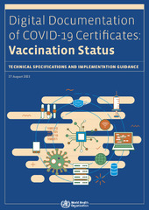
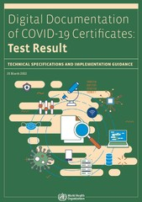
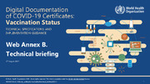
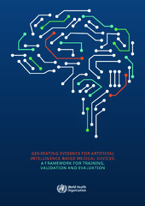

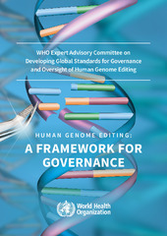
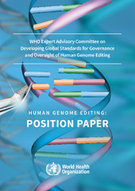
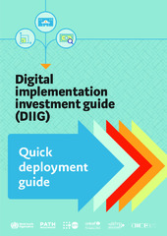

Total Control Timeline 2023+
IHR Emergency Law …permanently declared in every country
WHO Covid-19 Crisis Emergency Law Infodemic
Phase 1
Maintaining Covid19 fantom “VIRUS” = “Fear”
and Health System “failure”
⬇
WHO publications 2018 to now:
“Digital Documentation of Covid-19 Certificates”
Test Result, Vaccination Status,
Implementation, Telemedicine, etc
For governements, NGOs, hospitals, doctors, …
Phase 2
Total Control Data-AI-Biohacking
via IoBodies + IoThings + Smart Home/Cities + 5G+…
⬇
WHO publications since 2021+
“Human Genome Editing”
“Medical Devices Atlas 2022”
Mental Health & AI Solutions 2023
Digitalisation of human biology DNA
and AI health systems, vax ID,
digital biocode + bioradiation weaponry
©Astrid Stuckelberger, PD, PhD,

Slide 4
Biology to Epidemiology Level
Evidence + Scientific challenges 2023+
the impossible permanent “CovID19 Coronavirus”
➔ the impossible ”one for all experimental vaccine”
is the content biological or not?
→ proof of Concept
Result = NO! ➔ no Nitrogen + no phosphore
by spectrography (Dr Nagase (Can), Dr Monteverde (Arg), etc
- B –
Non Biological multidisciplinary Causality Analysis, including all factors such as Chemical and Radiation (Smart cities + houses)
- ID in the vial – body
. Chemical toxicity (Zb: metal)
- Radiation (oxide graph)
➔ Micro-Chemie, +17 microscopes, Specialists EMF/nanoTech
Synthetic nanotech related to Genome Editing CRISP-R
Environmental microwave radiation etc
- A –
Traditional Biological and Medical Knowledge causality
Virus = Infection
traditional Lab-clinical research
No public health causality!
DNA
mRNA
Spike Protein
Nucleus
©Astrid Stuckelberger, PD, PhD,

Slide 5

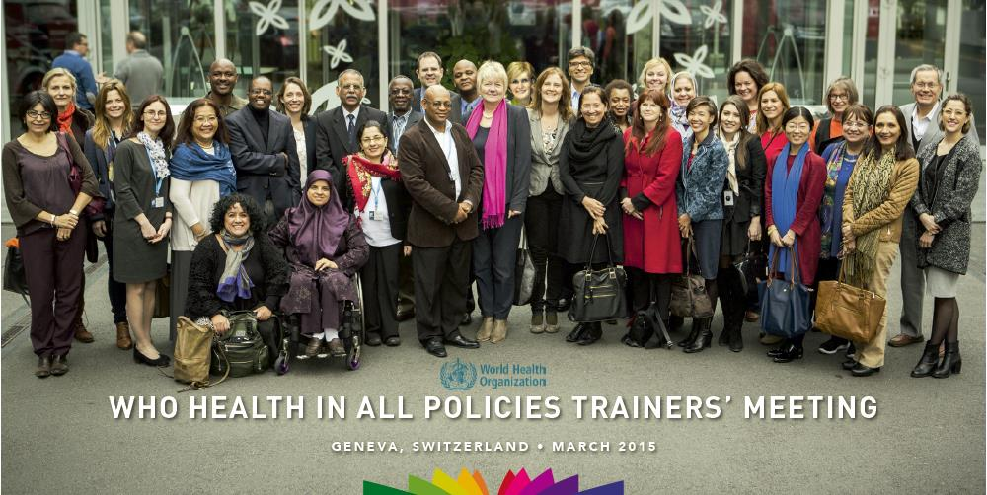

“HEALTH IN ALL POLICIES”
WHO Key Training Manual to implement WHO in all UN agencies
© from training given by Ilona Kickbusch (Treaty) for WHO in 2015-2017 to international country trainers
Astrid
Ilona K.

Slide 6
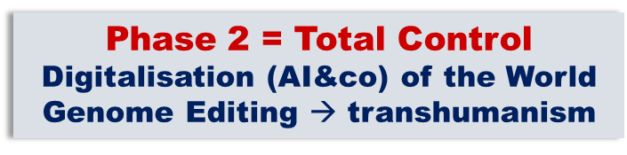
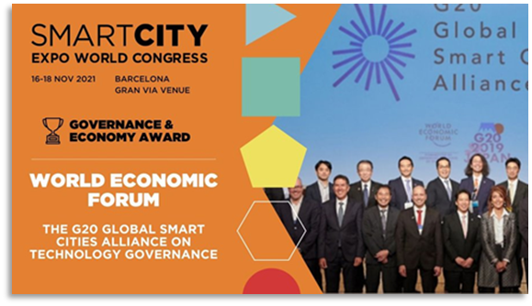
Smart Cities & Homes & Humans 5.0?
G20 Summit on 28–29 June 2019 - Japan
https://www8.cao.go.jp/cstp/english/society5_0/index.html
"A human-centered society that balances economic advancement with the resolution of social problems by a system that highly integrates cyberspace and physical space."
Society 5.0 proposed to UNESCO, then WEF at the G20 Summit
as a future society that Japan should aspire to.
Hunting society (Society 1.0)
Agricultural society (Society 2.0)
Industrial society (Society 3.0)
Information society (Society 4.0).
Ethical and Legal Issues : Regulation, Consent, Data Privacy + Biometric Protection?

Slide 7
WHO/UN vs People of the World
International Health Regulation
Pandemic Treaty
=
WHO Constitution hacking Sovereignty

Slide 8
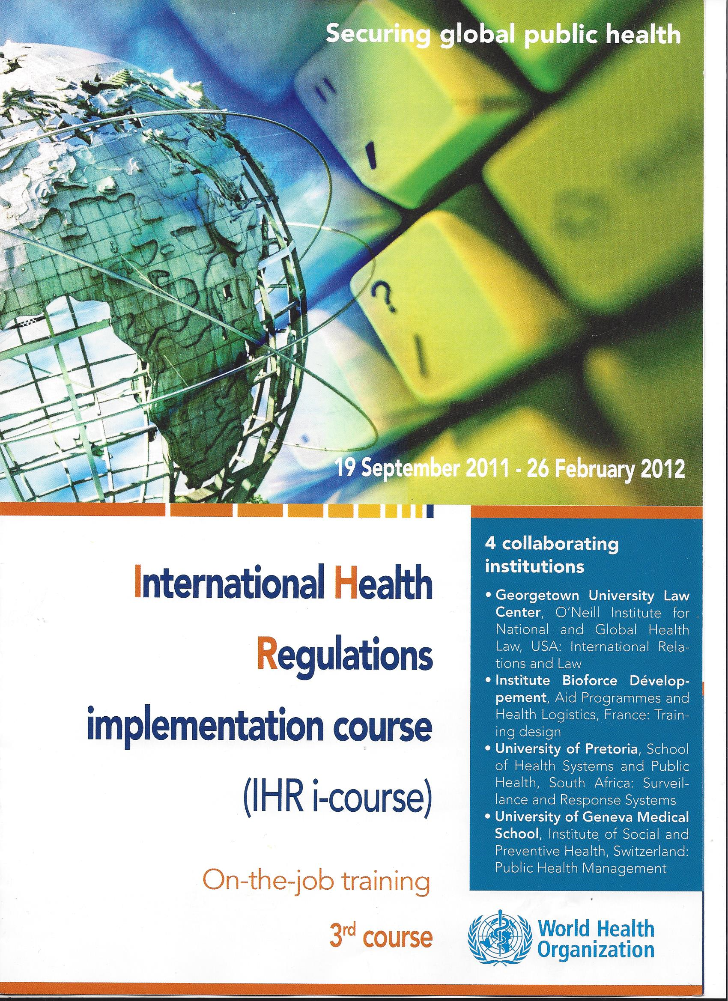

Causality: Risks to public health and the IHR (2005)
– WHO “all hazards approach” –
©AS from WHO lectures given on IHR Training 2009 to 2013
Biological agent:
virus? not isolated
Parasites
Bacteria
Non-biological
International Health Regulations (2005)
Infectious diseases
Food safety
Chemical safety
Radionuclear safety
Accidental & deliberate release
Product safety
Environmental hazards
Consequences of natural disasters
?
Metal:
- Chrome
- Nickel
?
Experimental Vaccine
Evidence in 2022-23…
Not safe
Not efficient
No immunity
High mortality and secondary effect
Nanotech
Radiation
ID, simili RFID
Oxyde graphene
?!!

Slide 9
WHO-IHR Management of public health risks
©AS from WHO lectures given on IHR Training 2009 to 2013
Shifting the epidemic curve to the left (the same principle applies to early detection and risk management of other hazards under the IHR)
Early warning leading to early intervention prevents transmission and reduces negative public health impact of disease outbreaks

Slide 10
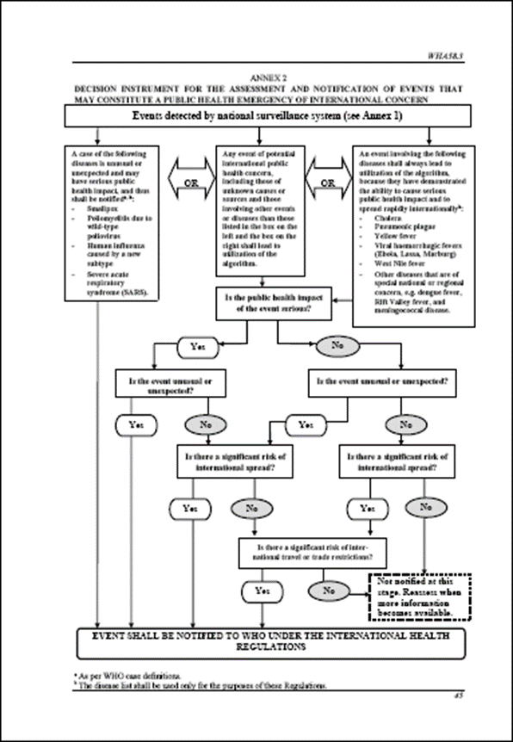
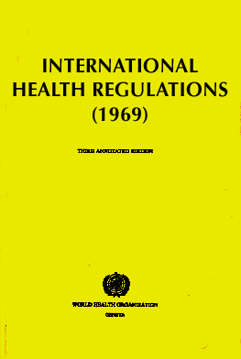
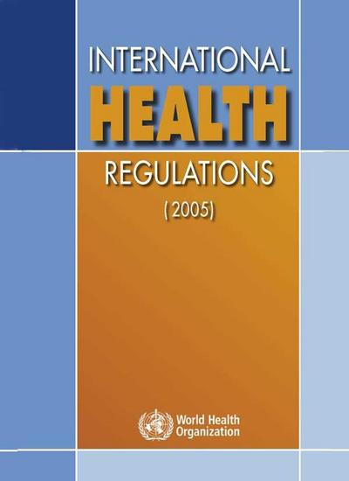
What’s new between IHR 1969 to IHR update in 2005?
Under Dr Gro-Harlem Brundltand, WHO Director-General first woman
From three diseases to all public health risks
From preset measures to tailored response
From control of borders to include containment at source
All risks approach
Respect of Human Rights and Data protection
(ex art. 3, 32, 23, 31, 35, 43…
Notes:
The IHR are innovative because
they move from purely a list of diseases to a dynamic process of risk identification, assessment and management
they move from a concept of static defence at borders, airports and ports to the concept of early detection, reporting and containment at source
they built on the concept that international health security is based on strong national public health infrastructure connected a global alert and response system.

Slide 11

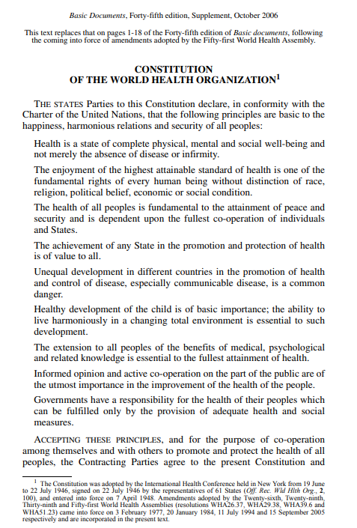
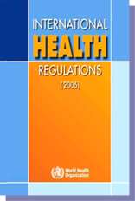
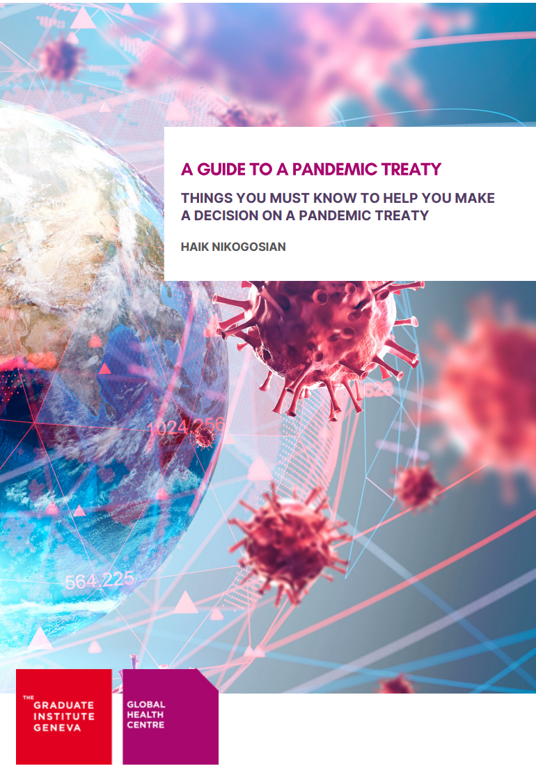
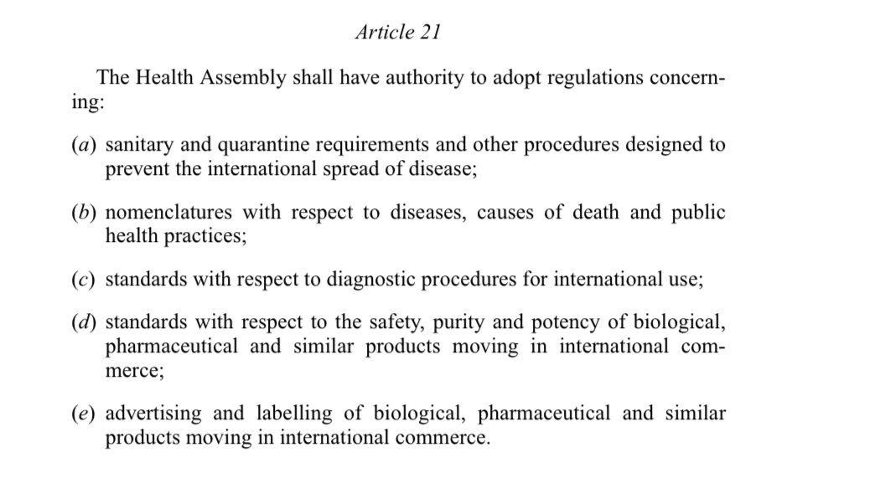

WHO 2-track process to impose “One World Together”
“One Health” – “Health in All Policies”
[..with AI.. → ref. WHO 2022-23]
source: www.apps.who.int
[retrieved 20 May 2022]
A
WHO 74th Assembly (extraordinary)
A new “Treaty” or Convention procedure is adopted in December 2021
IBN in charge of finalizing
In the making….up to 2024
B
The United States submits major amendments
to IHR in January 2022
+ September 2022
to be revised by MS dec22, adopted by 2/3 at the
WHO Assembly in 2023
Legal framework of A + B
WHO Constitution with the new “modified” IHR will govern the world,
superseding all constitutions of all member states at WHA 2024
(within 6 to 24 months from “adoption”)
Authors
H. Nikogosian & I. Kickbusch

Slide 12
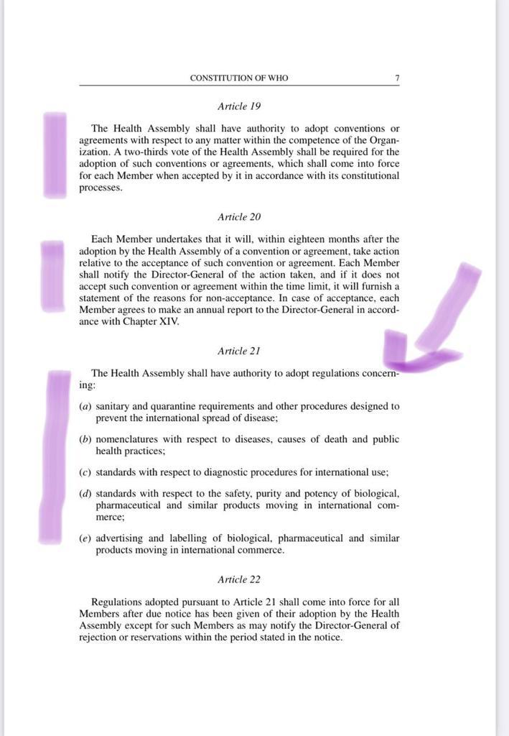
WHO Constitution adopted in 1948
especially: Preamble + articles 19 – 20 – 21 - 22
Preamble: related to the UN Charter
Articles 19 : mode of voting 2/3 = majority= yes
“ A two-thirds vote of the Health Assembly shall be required for the adoption of such conventions or agreements, which shall come into force for each member when accepted by it in accordance with its constitutional processes.”
Article 20 : mode if not accepted =explain reasons
Article 21 : everything you want to take over the health system
Article 22 (+ref. footnote): how to contest? Rejection or reservation - see tim limit
➔

Slide 13
WHO Constitution adopted in 1948
especially Preamble + articles 21
Article 21 : everything you need to take over the health and human life system

Slide 14
Law, Justice and Human Rights : some ideas of solutions
to massive violation of human rights, and criminal abuse of law and justice
WHAT TO DO when Governements = Enterprise
I - Counter legally the UN system ?
Letter of opposition or reservation
to WHO DG under article 20 + 22 of the WHO Constitution
within 6 months after adoption
+
Letter of opposition to the government by question/opposing any decision in citizens name
+
Security council and International UN Justice system ➔ ICC/ICJ?
II - Representativity and self-determination of people
Letter of opposition concerning the representativity of “member states”
+
strengthen self-determination of the population, culture (UN legal tools)
+
strengthen local regional constitutions
III - EXIT the System
(WHO and/or UN System as a whole
with all World Agendas, SDGs, technologies, etc)
Letter of opposition and exit
based on the Universal UN Charter and OHCHR
(for example based on article 110 UN Charter “ratification and signature”,
historical basis or many other reasons)
➔ NB: participate massively in the WHO public hearing..no impact!?
What should Switzerland do
to get out of the WHO/UN tyranny?
Reservation
(if temporary)
Opposition
EXIT
(if impossible to reverse)
What should Switzerland do
in all cases :
REINFORCE + EDUCATE
ALL CITIZENS (incl. Youth)
ON THEIR RIGHTS AND
NATIONAL CONSTITUTIONS
(as President Trump & Team
has just initiated in the United States)

Slide 15
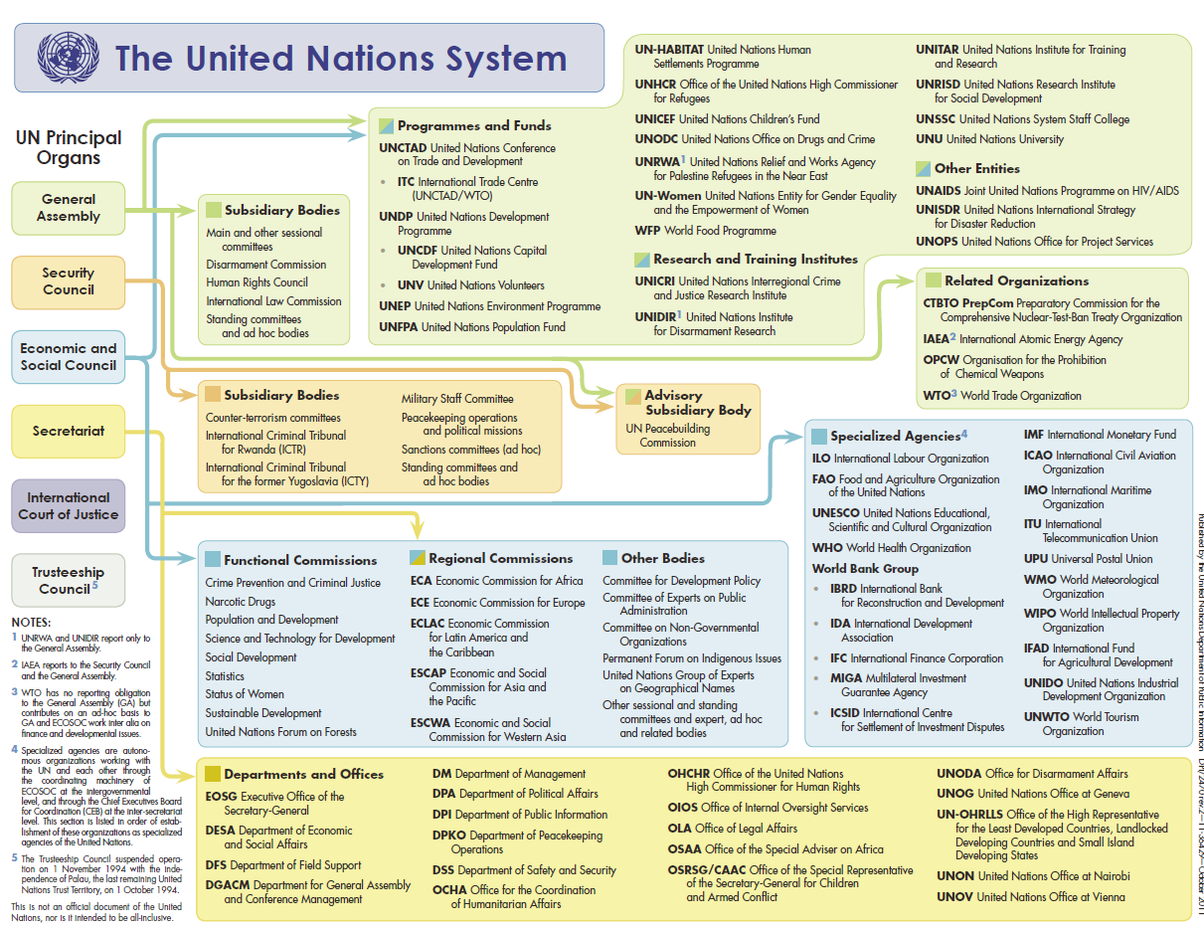
WHO : Justice, Law & Human Rights in the United Nations CEO System

